Slide 1
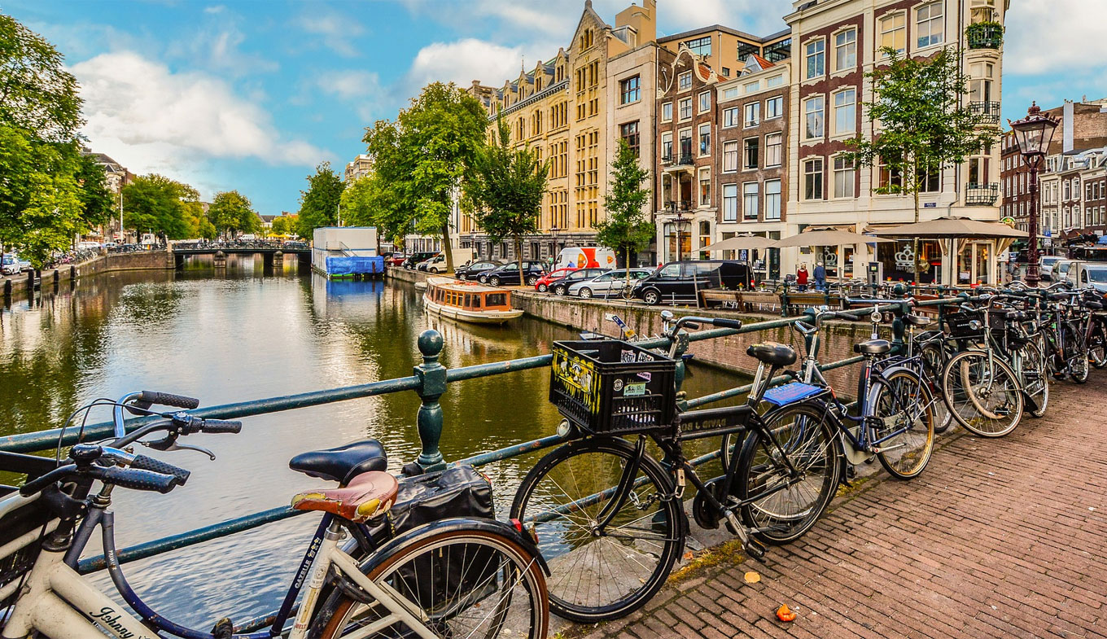
2019 European Seminar – Amsterdam, Netherlands

Slide 2
Regional Update

Slide 3
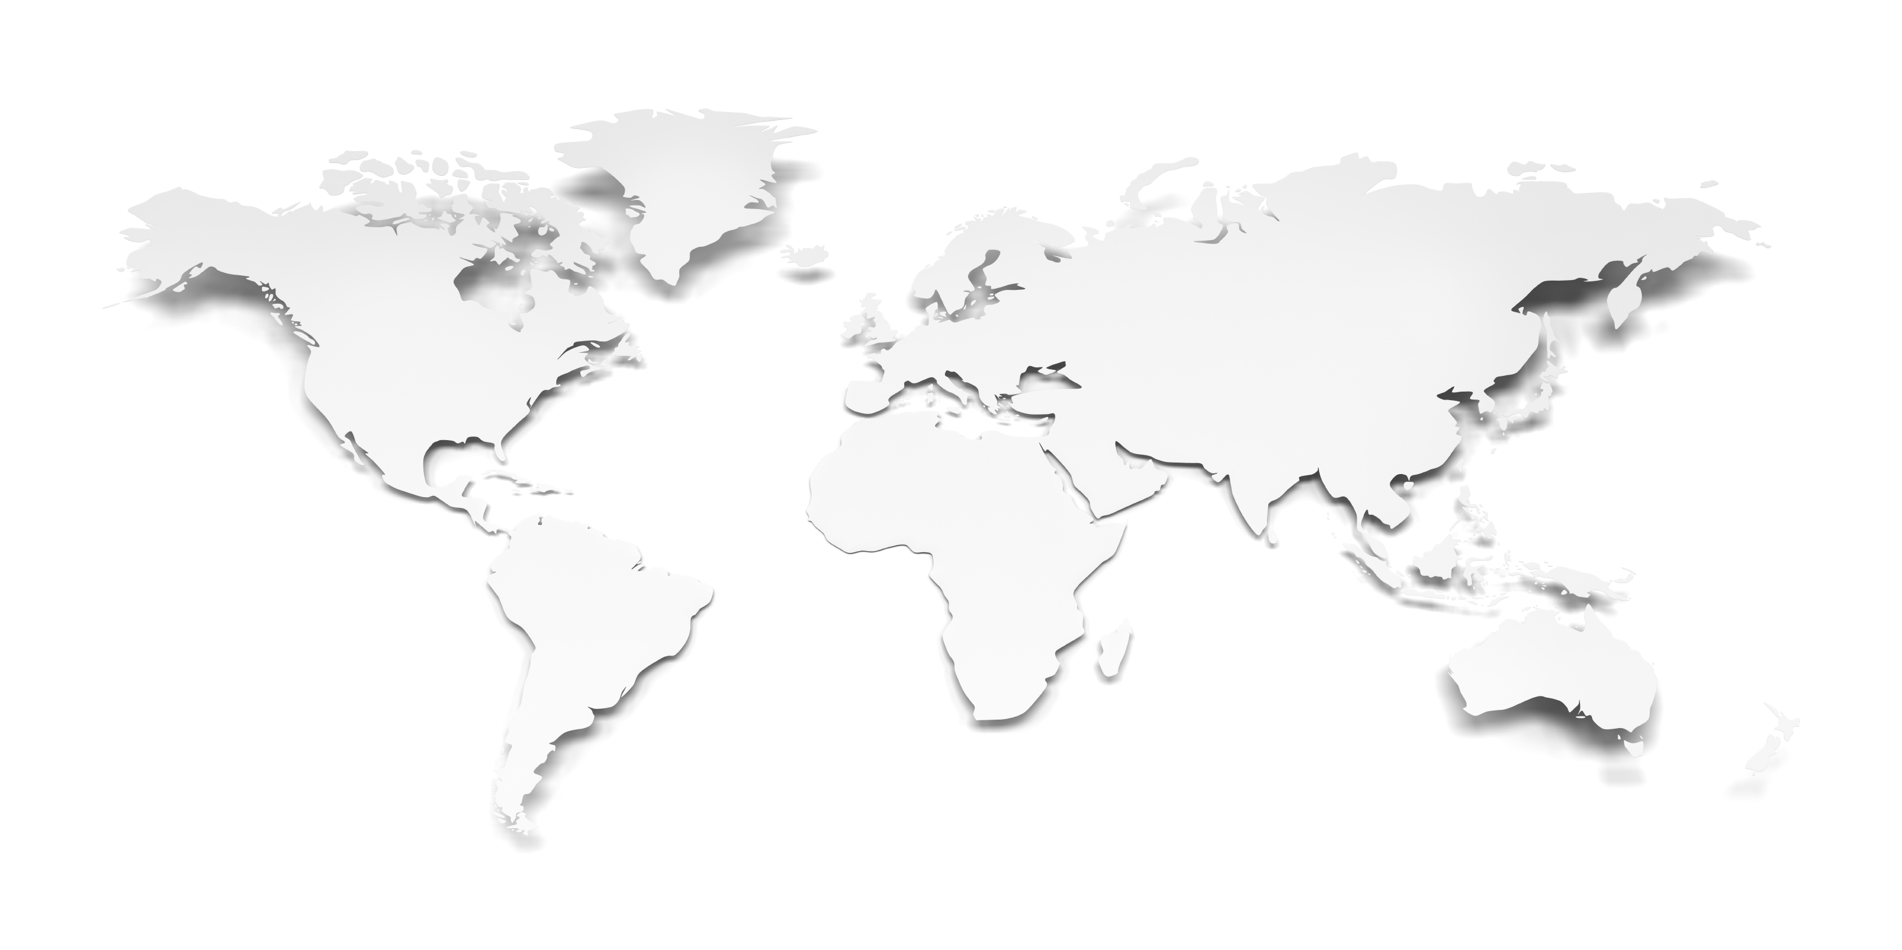

Global Partner Network
Vancouver
Delta Controls is one of the global leaders and BACnet pioneers
with Partners on every continent and in over 80 countries.

Slide 4
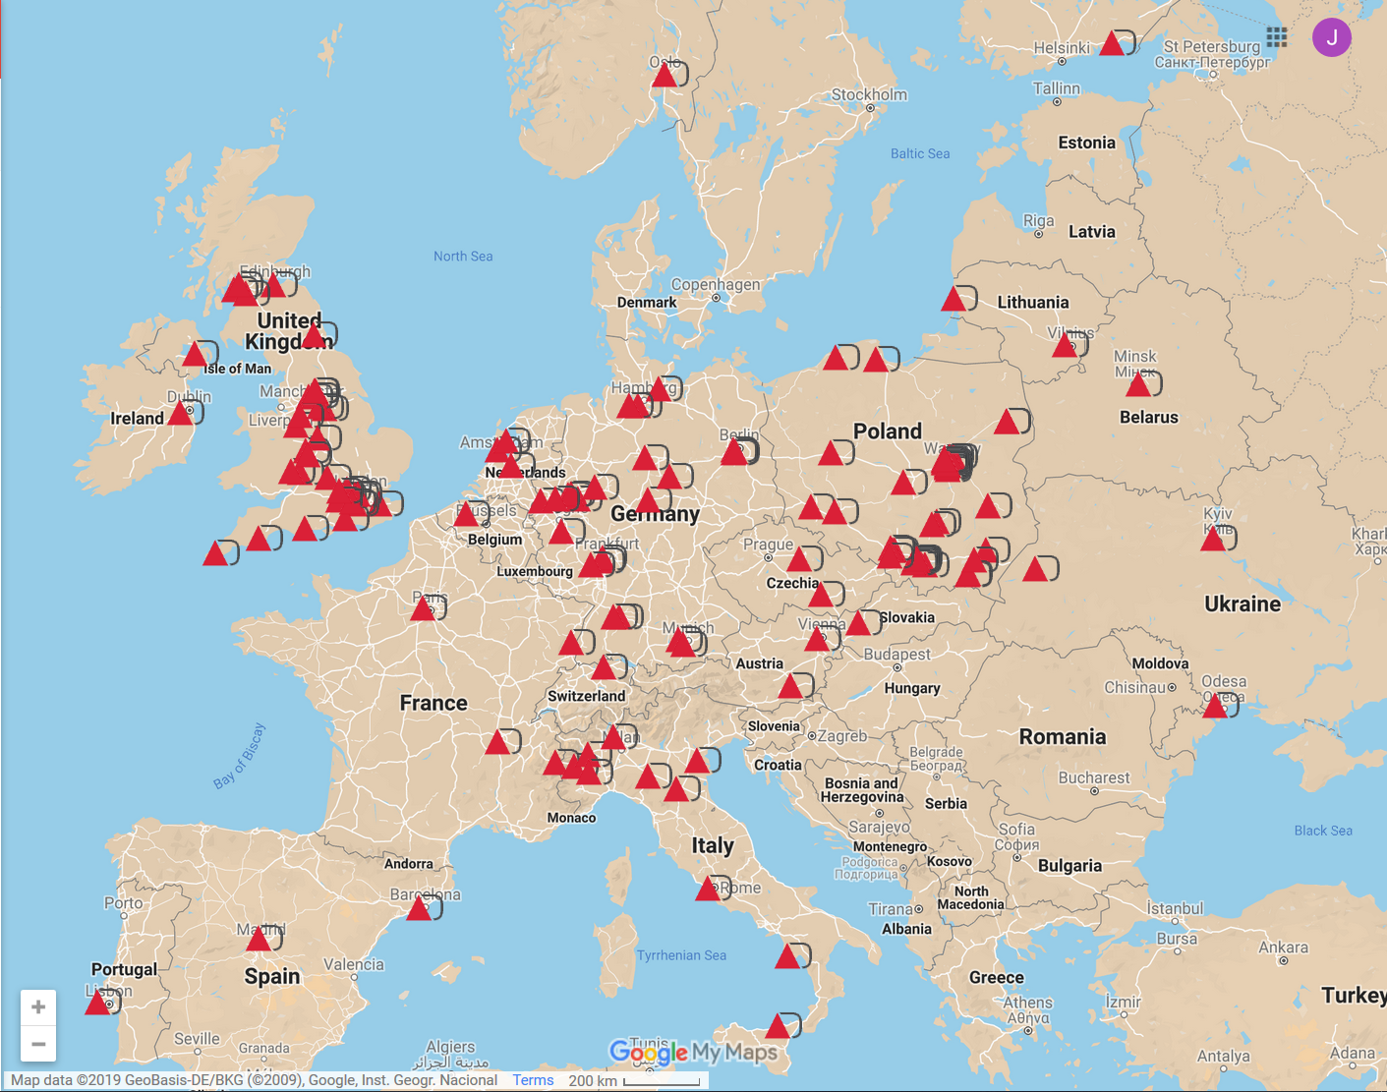
European Coverage

Slide 5
Regional Update

Slide 6
Partner Demographic
Notes:
,

Slide 7


Slide 8


Slide 9

Partner Sales
Notes:
,

Slide 10
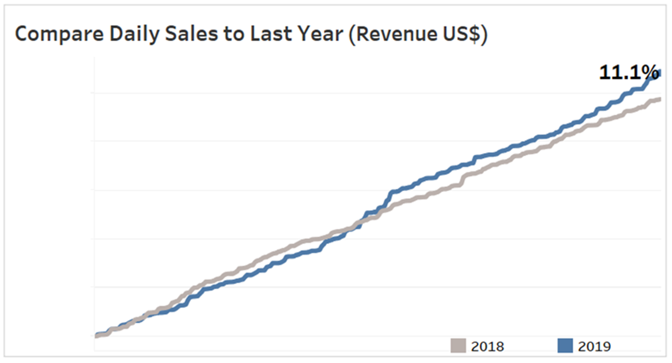
Year-on-Year YTD Sales

Slide 11
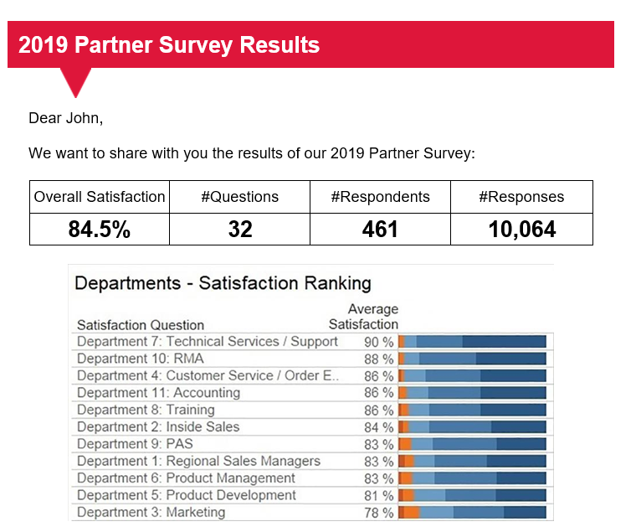
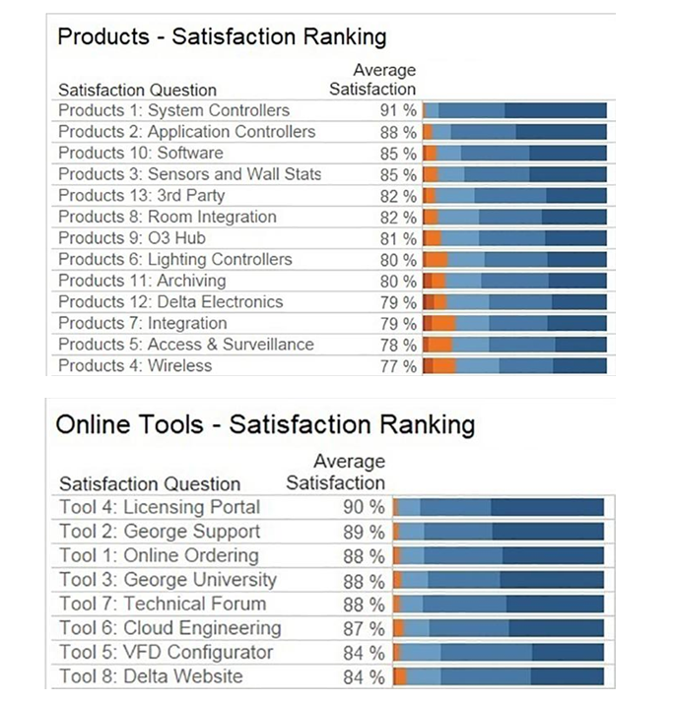
Partner Satisfaction Survey

