Slide 1

2019 European Seminar – Amsterdam, Netherlands
13:30 Welcome & Introduction
13:50 Regional Update
14:15 Product Roadmap
15:00 Break
15:30 O3-HUB 2.0
16:00 IoT & Cloud Ingestion
16:30 IoT Firmware (V4.9)
16:50 Tridium Integration
17:10 Open Mike #1
19:00 Networking Reception
20:00 Dinner
Agenda – Day 1

Slide 2
Welcome

Slide 3
George Wylie
OEM BDM Europe

Slide 4



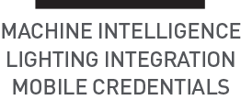




Slide 5
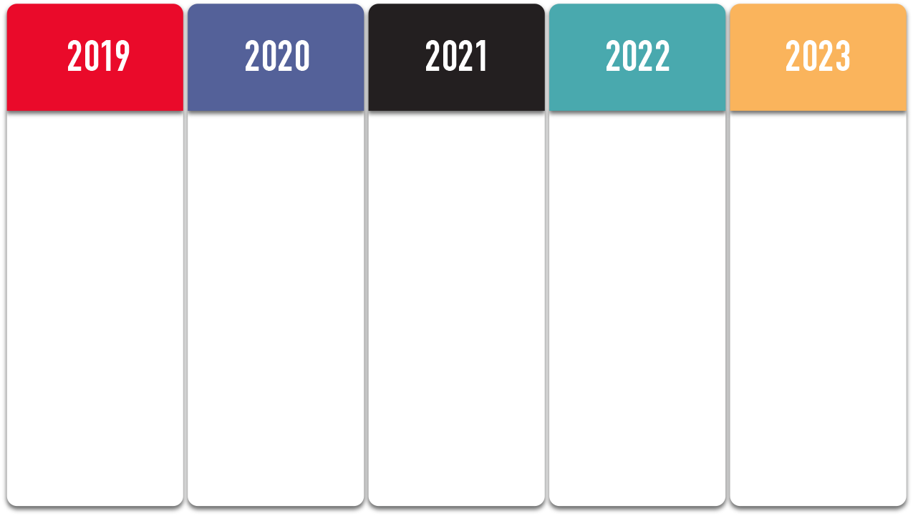



IoT & Data Sharing
Cloud & Energy
Access Control
Converged Platforms
Embedded WEB
TLS
BACnet SC
MQTT
IEEE 802.1x
OSDP
OpenADR
IoT connectivity on O3 and eBUS platforms
Secure Connect on IoT platforms
eWEB SaaS/Cloud
OpenADR on eWEB
O3 Access Control
Access Control enrollment, dashboards and reports
O3 integration with Vivotek
Connected Equip
Cloud SaaS
Access Control
BACnet SC
Kubernetes Container Management
Object System Accessibility
Connected Lighting
Cloud Deploy
Semantic Tagging
Mobile Connect (4GLTE,5G)
Continue network security
Enterprise Archiving
Connected Controllers
Cloud Deploy service
eWEB Semantic Tagging
O3 Hub 2.0
O3 Lighting Integration
Continued Access Control integration (VAST2)
Tridium Support
O3 VAV
Machine Intelligence
Lighting Integration
Mobile Credentials
Hardware Root of Trust
Machine Learning Algs
Embedded Python/NodeRed
Container Deploy
Audio Analytics
Workflow Templates/Libraries
O3 Hub 3.0
System level Lighting Integration
Space Utilization SW
Zero Touch Provisioning
Maintenance Services
Performance Services
Continued propogation of IoT controllers
Redundancy
BIM/MUD Support
BACnet/SC Hub on Verge
Command Center
Data Lake
Enterprise Integrations
Command Center
Dynamic Facial Recognition
Data Lake
System Control Analytics
Machine Learning continues
Command Center productization Application Services
Machine Learning at the system level
Delta Data Lake for predictive analytics and machine learning
New eSTAT
eVIZ next
Architecture Shift
Edge Computing
AI Services
Enterprise Service Bus
Edge Processing
AI Services
Command Center with ESB services
Virtualization
Notes:
READ FOCUS HIGHLIGHTS, NOT GOING TO READ ALL THE TECH AND IMP- (READERLESS DOORS, 03 HUB 2/3, DATA LAKES

Slide 6
Current Strategies and Plan
2019
2020
2021
2022
2023
IoT Framework
(Web, IPv6, MQTT)
Network Security
(BACnet/SC, 802.1x)
SAP,IBM,MSFT,etc
Connected
Equipment
Data Lake
Ingestion P2
ISO 27001
Certification
Delta Data Lake
IoT Strategy
Open Platform
Linux
Google HW/FW
Acceptance
NIST CSF
Monetization of Analytics
Gen 2 Archiving
eWEB SaaS
OEM Services
Cloud Eng 2.0
Cloud Deploy
Cloud Maintain
SaaS
Dev Ops
Reader-less
Doors
Cybersecurity
Surveillance
Integration
OSDP
VMS Integration
Facial Recognition
UL294
FIPS 201
Access Control
Existing Delta Channel
Security Channel
MSIs
Vivotek Workshops
Vivotek Smart Access Kit
Vivotek Channel
O3 Hub 2.0
IR People Counting
O3 Hub 3
Sensor Hub
Audio Analytics
Air Flow Sense
Location Services
SFO Requirements
KLIA Requirements
Health Care
Command Center Productization
Command Center
Notes:
Keybwords: Preperation, Foundation, definition, simplification Growth, expansion of current. Markets – increased partners and wallet share within buildings through those partners, OEM, Corporate accounts,

Slide 7
Delta Controls Product Roadmap
System
Unitary
Access
Software Services
Mgmt. Software
2020 Q1 |  |  | Q2 |  |  | Q3 |  |  | Q4 |  |  | 2021 Q1 |  |  | Q2
2019
EoY
eZNT-Wi
CONBT-USB
Service Tool
DE – UPS
Core Automation
Sensor Hub
2.0
BACnet Sensor
Sensor Hub 3
Space Utilization
O3 –2xP
Connected
Lighting Solutions
(Amerlux/DE)
O3/eBUS v4
Embedded Web P1
O3 VAV
Tridium
Engineering
eWEB
Container
(SaaS Scaleable)
The Delta Building
Verge
-CopperCube
Cloud
Eng 2.0
Archiving
V2.0 P1
Access
V4 Access
Control P2 (OSDP)
Vivotek VAST
Integration
Multi-Tenant
Mgmt Support
Reader-less Controller /
Mobile Credential
Connected
Devices
eWEB
SaaS
Self-Serve
BACnet SC
eWEB
Cloud
Hub Deploy
O3/eBUS v4
IoT Controller
Node Red
Cloud
Site Deploy
Access Control P2
Connected Equip
O3 Hub 2.0
Connected Equip P2
IoT SaaS
Connected Lighting
O3 Hub 3.0
ON RADAR
DASHBOARD
2019 Q4
2020 Q1
2020 Q1
2020 Q3
2020 Q4
2021 Q1
2021 Q2
…
Command Center
Next Gen Controller (ML)
eSTAT
OSDP
Multi-Fact Auth
UL294
People counting
License Plate
O3/eBUS/eWEB
Net Secure 802.1x
BACnet SC
Web Server P1
MQTT
Generic BACnet
Thermal Load
Improved Range
IoT Connectivity
Bluetooth API
O3 VAV Module
Node Red IoT Platform
Device Analytics
Device Autonomy
Cloud Deploy
Cloud Maintain
DALI 2.0
BTLE
People Counting
Audio Signatures
Asset Tracking
Notes:
EZNTWI- (BACNET/IP OVER WIFI STILL HAS ALL THE USUAL EZNT TOOLS AND LETS YOU USE ADVANCE CONTROL STRATEGIES LIKE DEMAND CONTROL VENTILATION SAVING ENERGY WITHOUT HURTING USER COMFORT, GREAT RETROFIT FOR NON COMMS THERMOSTATS.
OSDP-OPEN SUPERVISED DEVICE PROTOCOL (ACCESS SUCRITY STANDARD)

Slide 8
European Seminar – Amsterdam 2019
from 06:30 Breakfast at your convenience
09:00 Access Control
09:30 Vivotek
09:50 GRMP
10:00 Global Conference 2020
10:15 Break
10:45 Apollo House
11:15 Trade Shows 2020
11:35 Training Schedule
11:55 Open Mike #2
12:15 Summary & Close
Agenda – Day 2

