Slide 1
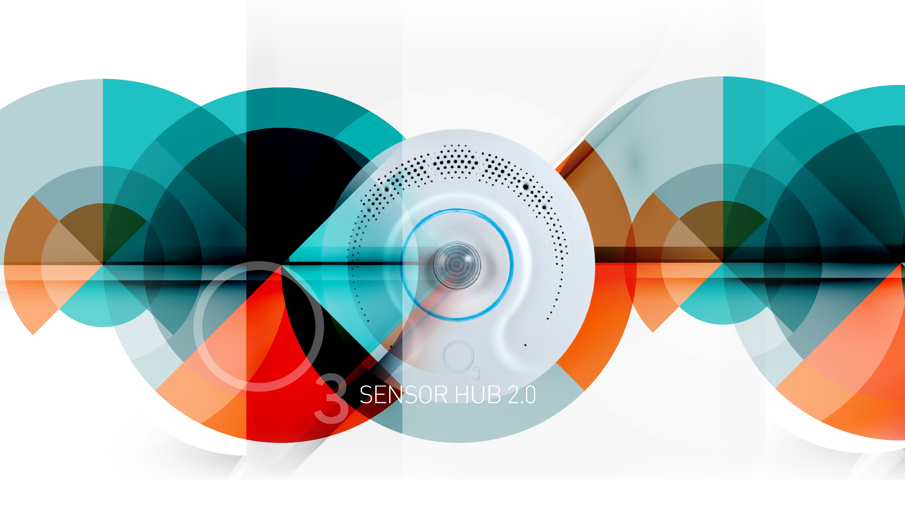

Notes:
(Presentation Target Audience: Controls Manufacturers.)
Today, I am excited to share with you the future of multi-sensor product technology in the form of the O3 Sensor Hub Version 2.0.
Message: This next version of the O3 Sensor Hub combines multi-sensor technology with IoT infrastructure to create seamless integration between room engagement and building services. This is important because failure to combine room engagement and building services components into your solution will result in lost revenue and unhappy customers.

Slide 2
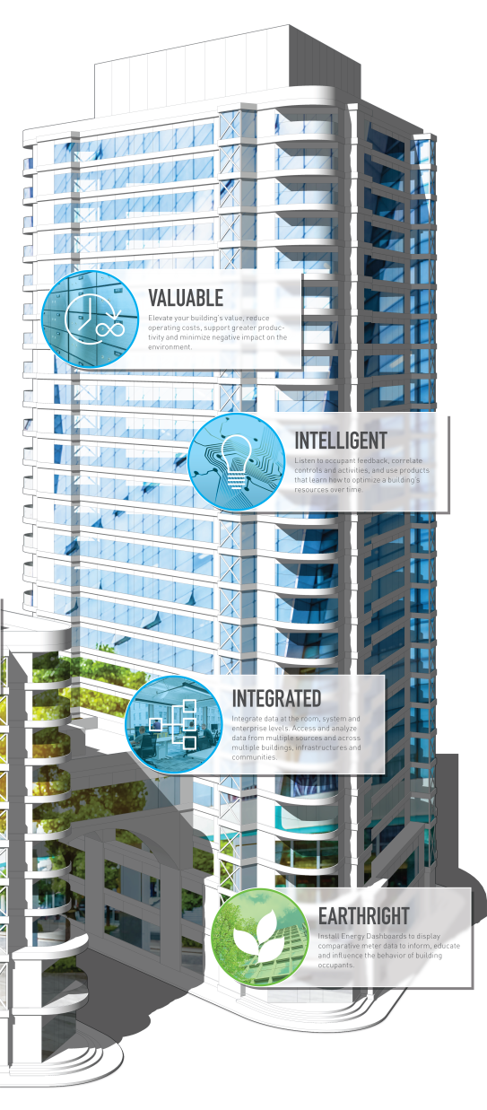
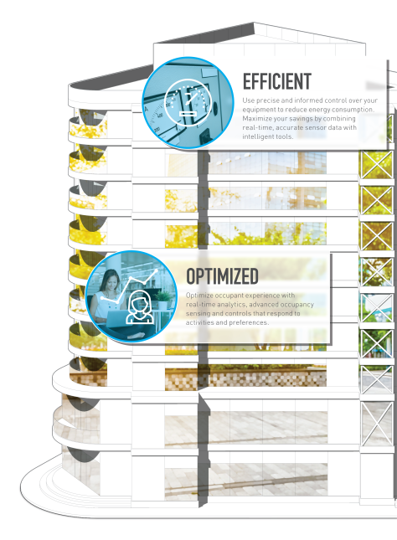
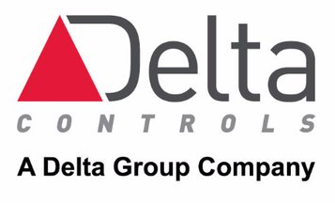
The Delta Vision The creation of a building that’s organic…
To achieve our vision we continue to create tools and products for buildings.
One such tool is the O3 Sensor Hub – The eyes and ears of the building.
Notes:
Preview to the Delta Vision: Delta Controls is committed to creating products that redefine how a conventional building functions and operates. One of the ways we are showing this commitment is though the creation of a new multi-sensor product that meets the needs of many different vertical markets and spaces. This solution introduces technology and features that will excite controls manufactures, installers and building owners alike.
The Delta Controls Vision: At Delta Controls we have a vision of a world where buildings are different than they are today. In our vision these structures are Intelligent, Efficient, Optimized, Integrated and Valuable. More specifically they reject the current norms of a static space where people simply work, or rest, or play. In our vision, buildings are organic, they grow and evolve with the needs of its occupants transforming the building experience into an effortless engagement of function and satisfaction. To achieve this vision we create tools. One such tool is the O3 Sensor Hub – the eyes and ears of the building

Slide 3
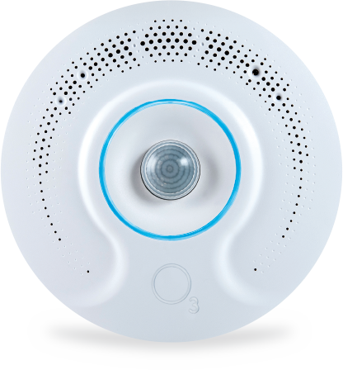


O₃ Sensor Hub Vision
“To become the Industry standard between
room engagement and building services.”
The second generation Sensor Hub is an open platform -
with multiple interfaces that make it possible to communicate
with and integrate into almost any system.
“ Remember that time is money.”
Benjamin Franklin
Notes:
Our Product Vision: The O3 Sensor Hub is the future of multi-sensor products as it combines start-of-the-art technology into a functional easy-to-use device that is unobtrusive to building occupants. The result, a seamless blend of room occupancy and comfort with room utilization. As leaders in room sensing and control technology we believe this product has the potential “to become the industry standard between room engagement and building services”.

Slide 4


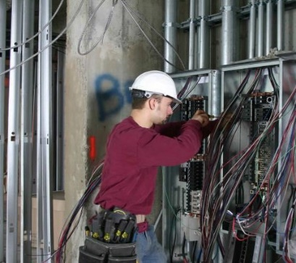

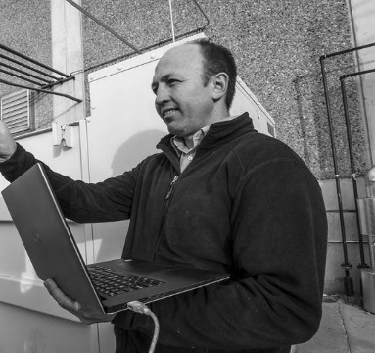
Defining the Audience
Top Five Audience Groups Identified
Planning
& Configuring
Installing & Provisioning
Consulting / Mechanical Engineer
Application Engineer
Electrical Foreman
Electrical Apprentice
Building Owner / Manager
Notes:
Our Product Vision: The O3 Sensor Hub is the future of multi-sensor products as it combines start-of-the-art technology into a functional easy-to-use device that is unobtrusive to building occupants. The result, a seamless blend of room occupancy and comfort with room utilization. As leaders in room sensing and control technology we believe this product has the potential “to become the industry standard between room engagement and building services”.

Slide 5
Engineers:
Planning & Configuring
Tasks:
1. Plan which devices to use and how to use them
2. Design and implement device configuration
3. Communicate plan to installers
4. Troubleshoot problems during install
Challenges:
1. Handoff process with installers
2. On-premise servers getting unplugged
Notes:
The Product – What it does! The O3 Sensor Hub is a product that observes its surrounding environment and reports its findings back to a controller or supervisory platform. To achieve this, it uses our patented Sensor Fusion technology to monitor over eight space characteristics. These eight characteristics are then digitized and sent to associated controllers and BMS supervisor. A connection to the cloud allows for virtually touchless installation, setup, and commissioning practices and provides for the creation of a unique yet simplistic user engagement platform.

Slide 6
Streamline project turnover to field
“We’re trying to make things
as easy as possible for electricians.
Saving installers’ time means cost savings for all.”
Morgan, Applications Engineer
Notes:
The Product – What it does! The O3 Sensor Hub is a product that observes its surrounding environment and reports its findings back to a controller or supervisory platform. To achieve this, it uses our patented Sensor Fusion technology to monitor over eight space characteristics. These eight characteristics are then digitized and sent to associated controllers and BMS supervisor. A connection to the cloud allows for virtually touchless installation, setup, and commissioning practices and provides for the creation of a unique yet simplistic user engagement platform.

Slide 7
Electricians:
Installing & Provisioning
Tasks:
1. Plan which devices go where
2. Install devices
3. Commission devices
4. Troubleshoot problems
5. Calibrate devices (e.g. temperature)
Challenges:
1. Handoff process with engineers
2. Job site connectivity (dead zones, no power)
3. Long wait times for engineers & commissioning agents
Notes:
The Product – What it does! The O3 Sensor Hub is a product that observes its surrounding environment and reports its findings back to a controller or supervisory platform. To achieve this, it uses our patented Sensor Fusion technology to monitor over eight space characteristics. These eight characteristics are then digitized and sent to associated controllers and BMS supervisor. A connection to the cloud allows for virtually touchless installation, setup, and commissioning practices and provides for the creation of a unique yet simplistic user engagement platform.

Slide 8
New ways of simplifying
“I don’t typically configure devices, but the
more we can do on the job site, the better.
If anything goes wrong, we wouldn’t have
to wait around or figure out how
somebody else has labelled devices.
It could save up to 75% of our install time.”
Will, Foreman Electrician
Notes:
The Product – What it does! The O3 Sensor Hub is a product that observes its surrounding environment and reports its findings back to a controller or supervisory platform. To achieve this, it uses our patented Sensor Fusion technology to monitor over eight space characteristics. These eight characteristics are then digitized and sent to associated controllers and BMS supervisor. A connection to the cloud allows for virtually touchless installation, setup, and commissioning practices and provides for the creation of a unique yet simplistic user engagement platform.

Slide 9
App Demo:
Quick & Simple

Slide 10
The O3 Experience
Notes:
The Product – What it does! The O3 Sensor Hub is a product that observes its surrounding environment and reports its findings back to a controller or supervisory platform. To achieve this, it uses our patented Sensor Fusion technology to monitor over eight space characteristics. These eight characteristics are then digitized and sent to associated controllers and BMS supervisor. A connection to the cloud allows for virtually touchless installation, setup, and commissioning practices and provides for the creation of a unique yet simplistic user engagement platform.

Slide 11
User
Feedback

Slide 12
Usability Test Group
Electricians, LV, HVAC and tech leads
with 2–25+ years of experience
working with installations on-the-job
Have experience with Delta Controls and
ESC Automation products
8
3 - HVAC & Management (16, 20, 25+ years)
2 - HVAC (7 years & 22 years)
2 - Electricians (2 years & 9 years)
1 - Low Voltage (10 years)
50%
Notes:
The Product – What it does! The O3 Sensor Hub is a product that observes its surrounding environment and reports its findings back to a controller or supervisory platform. To achieve this, it uses our patented Sensor Fusion technology to monitor over eight space characteristics. These eight characteristics are then digitized and sent to associated controllers and BMS supervisor. A connection to the cloud allows for virtually touchless installation, setup, and commissioning practices and provides for the creation of a unique yet simplistic user engagement platform.

Slide 13
Overall Impressions
We asked: How would you describe your experience with this app?
7 Electricians - “Easy to understand” - Average rating of 6.75/7
6 Electricians/1 HVAC - “Straight-forward” - Majority of users reported
6 Electricians/1 HVAC - “Simple” - Average rating of 6.25/7
Notes:
The Product – What it does! The O3 Sensor Hub is a product that observes its surrounding environment and reports its findings back to a controller or supervisory platform. To achieve this, it uses our patented Sensor Fusion technology to monitor over eight space characteristics. These eight characteristics are then digitized and sent to associated controllers and BMS supervisor. A connection to the cloud allows for virtually touchless installation, setup, and commissioning practices and provides for the creation of a unique yet simplistic user engagement platform.

Slide 14
Differentiating
Features

Slide 15
Portability Saves Time
“Having something portable to walk around in
your pocket would simplify installers’ jobs.
It’s the difference between all day (or week)
compared to a couple hours.
I wouldn’t have to work with someone else;
save time, save money.”
re: overall user experience
Notes:
The Product – What it does! The O3 Sensor Hub is a product that observes its surrounding environment and reports its findings back to a controller or supervisory platform. To achieve this, it uses our patented Sensor Fusion technology to monitor over eight space characteristics. These eight characteristics are then digitized and sent to associated controllers and BMS supervisor. A connection to the cloud allows for virtually touchless installation, setup, and commissioning practices and provides for the creation of a unique yet simplistic user engagement platform.

Slide 16
O₃ Sensor Hub 2.0 Communication & Connections
Native BACnet communications
Dual-port Ethernet connection
IoT protocols - MQTT and REST
Bluetooth Low Energy (BLE)
APIs will be published to allow for 3rd party development and integration
Notes:
Call to Action: Now that we’ve provided you with a summary of what’s to come, I encourage you to review some of our other documents on the O3 Sensor Hub 2.0 product. These other documents include a specification document as well as a use case document. The Specifications document provides more details into the technical capabilities of the product and the use case document provides greater insight into different vertical markets and uses within these markets where the product provides its users with an enhanced experience.

Slide 17
O₃ Sensor Hub 2.0 Communication & Connections
One of Delta Controls’ Connected Equipment/IoT devices
Native BACnet capability - it will operate with any BACnet compliant controller
MQTT and REST - other custom applications can be written to interface directly with the Hub 2.0
True BLE interface – Android and iOS apps can communicate with the Hub even if no other network connection is available
APIs published so that customers can extend App and Dashboard support
O3 app for provisioning and configuring devices quickly and easily
Notes:
Call to Action: Now that we’ve provided you with a summary of what’s to come, I encourage you to review some of our other documents on the O3 Sensor Hub 2.0 product. These other documents include a specification document as well as a use case document. The Specifications document provides more details into the technical capabilities of the product and the use case document provides greater insight into different vertical markets and uses within these markets where the product provides its users with an enhanced experience.

Slide 19
O₃ Sensor Hub 2.0 The Value
Cloud platform
Engineering workflow reusability
Compounded time savings with continued use
Distributed templates for centralized job site configuration
Remote monitoring
Improved communication between installer and engineer
Interoperability
Efficient communication directly with devices through BLE
Open standards
Well documented APIs
Notes:
Call to Action: Now that we’ve provided you with a summary of what’s to come, I encourage you to review some of our other documents on the O3 Sensor Hub 2.0 product. These other documents include a specification document as well as a use case document. The Specifications document provides more details into the technical capabilities of the product and the use case document provides greater insight into different vertical markets and uses within these markets where the product provides its users with an enhanced experience.

Slide 20
Future
Opportunities

Slide 23
Q&A

Slide 24
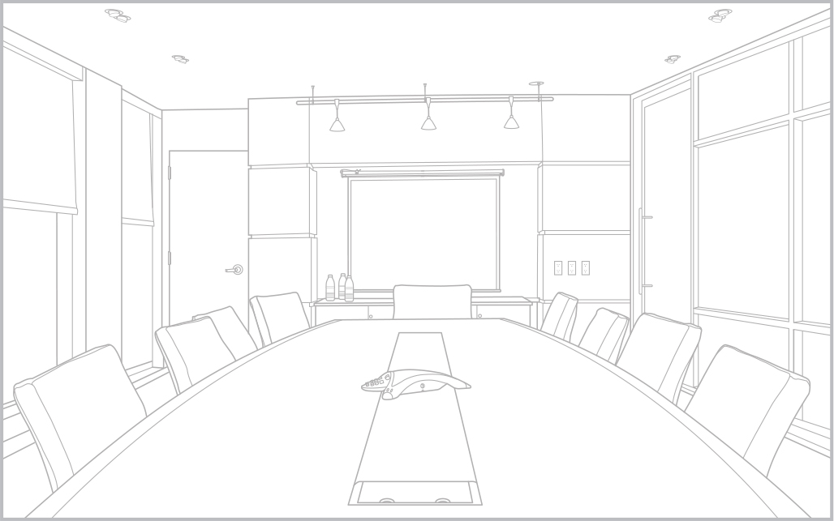




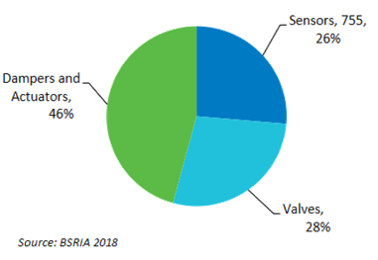



O₃ Sensor Hub 2.0 The Product
OBSERVE & REPORT The O3 Sensor Hub will observe its surrounding environment and report it’s findings back to a controller or the supervisory platform.
SENSOR FUSION TECHNOLOGY Sensor Fusion Technology monitors over eight space characteristics, then sends a combination of raw and processed data to local controllers and supervisory systems.
WHAT IT DOES!
CLOUD CONNECTIVITY & USER ENGAGEMENT Virtually touchless installation, setup and commissioning practices combined with unique yet simple user engagement methodologies.
Notes:
The Product – What it does! The O3 Sensor Hub is a product that observes its surrounding environment and reports its findings back to a controller or supervisory platform. To achieve this, it uses our patented Sensor Fusion technology to monitor over eight space characteristics. These eight characteristics are then digitized and sent to associated controllers and BMS supervisor. A connection to the cloud allows for virtually touchless installation, setup, and commissioning practices and provides for the creation of a unique yet simplistic user engagement platform.

Slide 25


O₃ Sensor Hub 2.0 Our Audience…
TARGET VERTICAL MARKETS
Commercial
Healthcare
Education
Hospitality
Retail
TARGET SPACES
Personal Offices
Open Office environments
Conference Rooms
Hotel Rooms
Patient Rooms
Classrooms
Retail outlets
Notes:
While introducing this product, you may have already started thinking about all the possible vertical markets and room types our solutions can help enhance. Such examples include commercial office spaces, Healthcare, Education, Hospitality and retail.
Just imagine employees with personal offices having the capability to view and control the characteristics of their environment from either a mobile or web-based app. Or the conference room that instantaneously reacts to an increase in occupants, quickly neutralizing the temperature increase at the start of a meeting as opposed to five minutes into the meeting.
We can’t forget about the nurses who now have an ability to view the environmental characteristics of each room from the computer located at the nurse’s station, making it easy for them to get feedback and make adjustments to the space improving patient care and comfort.

Slide 26
O₃ Sensor Hub 2.0 Technologies – What you get!
CONVERGING TECHNOLOGIES
SENSOR FUSION Multiple sensors found in one package – all combined to understand the space environment.
DUAL-PORT ETHERNET Easy installation, High-speed data transfer.
PROVIDING DATA WHERE YOU WANT, WHEN YOU WANT MQTT, BACnet, BTLE, REST API
EMBEDDED METRICS Onboard algorithms used to help identify the operation, functionality, and reliability of the device.
03 APP An app for both mobile and web-based platforms – your gateway to O3 Control.
TWO UNIVERSAL I/O Two universal inputs and outputs provide rudimentary control straight from the Hub.
ONBOARD USER FEEDBACK Our LED ring and audio outputs provide immediate user feedback to environment changing conditions.
THERMAL LOAD REPORTING Identify and report human load changes in real time.
Notes:
Technology! Simply put, the Sensor Hub is packed with technology. From hardware improvements such as its embedded sensor clusters (which we call Sensor Fusion) and its dual Ethernet ports all the way to firmware and software enhancements such as the O3 App and Thermal Load Reporting, the product has the capability to get the job done in a range of different configurations and environments.

Slide 27
O₃ Sensor Hub 2.0 Technologies – Don’t forget…
CONVERGING TECHNOLOGIES CONTINUED
CLOUD CONNECTIVITY Access O3 Hubs anytime, anywhere.
SECURITY & USER PERMISSIONS IoT-based security practices and configurable user permissions ensures your building is safe and secure.
SIMPLE LOCATION SERVICES Places the display/thermostat in the hands of the occupants.
VARIABLE INSTALLATION HEIGHT LOCATIONS With a variable mounting height of 8-15ft the O3 Sensor Hub can be installed in 94% of commercial rooms worldwide.
LIST OF SENSORS INCLUDES:
Temperature Sensor – Two Internal Air Temperature sensors
IR Temperature Sensor
Humidity Sensor
PIR Motion Sensor
Audio Sensor
Light Sensor – Monitors Lux and RGB Proportions
CIR Interface (IR Remote Control)
ENOCEAN CONNECTIVITY
EnOcean connectivity provides the options to add more sensors and room interaction points - the possibilities of what you can do are endless.
Notes:
Other notable mentions include: “Simple Location Services”, an ability to install the product at heights that range from 8 to 15 feet, as well as cloud connectivity. Not only have we created a product that very good at observing its surroundings, but it is also good at communicating what it finds to the devices that need this information.

Slide 28
O₃ Sensor Hub 2.0 Features
V2.0 PROVIDES
FEATURES FOR CONTROLS
MANUFACTURERS
Connectivity protocols and associated hardware
Sensor Fusion utilizes PIR and passive audio sensing to create smart occupancy sensing.
Temperature & humidity sensing at occupant height with multiple sensors using Sensor Fusion through local analytics.
Built-in light intensity and light color temperature sensing is ideal for daylight harvesting strategies and other light control algorithms.
FEATURES FOR INSTALLERS
Setup and commissioning of the devices in a generic yet scalable manner
With a top-down view from the center of the room, the O3 sensor Hub delivers a complete sensing solution in a sleek, consolidated package.
Removes the need to install multiple sensors across the room
Reduced cost of room-level integration
FEATURES FOR BUILDING OWNERS
The acquisition of real-time space utilization data and analytics
An optimized space that is driven by data
Eliminates the visual clutter that can overtake walls and ceiling.
The creation of a technology driven, efficient workplace
O3 App: Hand held & workstation control creating profiles to control the space.
Activity Based Control.
Notes:
O3 Sensor Hub Features. When it comes to product features, the O3 Sensor Hub has them in spades. Controls Manufacturers will appreciate that it comes with over 8 embedded sensors and local analytics used to help the device “sense” the world around it. Furthermore, the Sensor Hub is BACnet IP rev 18 compatible meaning it can connect to any BACnet enabled controller – giving it greater flexibility in the applications and devices it can connect to within a space.
The technicians installing the product will appreciate how easy it is to setup and commission the device. This is because we use IoT-based technology and concepts to easily configure these devices, allowing the techs to save time on each install.
Building owners will appreciate the O3 App and that it can be loaded onto both a mobile device and used as a web app on a local, or remote workstation.

Slide 29
O₃ Sensor Hub 2.0 Benefits
v2.0 provides:
BENEFITS FOR CONTROLS MANUFACTURERS
Multiple temperature Inputs
Employs Machine Learning Methods
Fast Response Time
Large Field Of View (PIR senses 33ft in diameter)
Sensor Fusion: Combining Audio Detection and thermal shifts
Silent alarms and situation detection
Integrated cleanly with existing BACnet Systems
BENEFITS FOR INSTALLERS
Installation Costs: 6 devices in 1
Fewer systems required in room
Less cost to move location and walls
Costs less to install than traditional systems
Faster installation
Located for easier integration installation
Architect friendly with the elimination of wall acne.
Fast hardware upgrade – twist in mount
Radiant heat load calibration
No solar gain
BENEFITS FOR BUILDING OWNERS
A more vibrant, inviting, and responsive workspace. Higher worker satisfaction and productivity.
End user experience brings the controls to the occupants location within the room rather than on the walls
Immediate cost savings; reduced energy, operations, and maintenance costs
No vandalism or tampering and sterile for hospital use.
Activity based App with auto-location
‘Learning’ during unoccupied state – no false unoccupied state
User trust from unit interaction and acknowledgement
Energy efficient – Faster response time to thermal load changes than traditional sensors.
Greater accuracy. Sensor Fusion & mounting location improves accuracy over traditional temperature sensors
Notes:
O3 Sensor Hub Benefits. In summary, the O3 Sensor Hub is a multi-sensor product specifically designed to bridge the gap between room engagements and building services. It uses a range of different technologies in order to make the product functional yet intuitive in use. The result, a product that has a fast response times to changes in room activity as well as a product that is immune from solar gain. The O3 Sensor Hub is also architect friendly and provides a more vibrant, inviting and responsive work environment to the people who occupy the space. This environment is bound to make employees much happier with their working environment and the guests pleased to visit.

Slide 30
O₃ Sensor Hub 2.0 Supporting Documents
To help in the understanding and communication of this O3 Sensor Hub 2.0 product, we have developed some supporting documentation.
O3 Sensor Hub Specification Document
O3 Sensor Hub v2.0 Use Case Document
O3 Sensor Hub v2.0 developmental Gantt Chart
Stay tuned… more documents to come!
Notes:
Call to Action: Now that we’ve provided you with a summary of what’s to come, I encourage you to review some of our other documents on the O3 Sensor Hub 2.0 product. These other documents include a specification document as well as a use case document. The Specifications document provides more details into the technical capabilities of the product and the use case document provides greater insight into different vertical markets and uses within these markets where the product provides its users with an enhanced experience.

