Slide 1

2019 European Seminar – Amsterdam, Netherlands

Slide 2
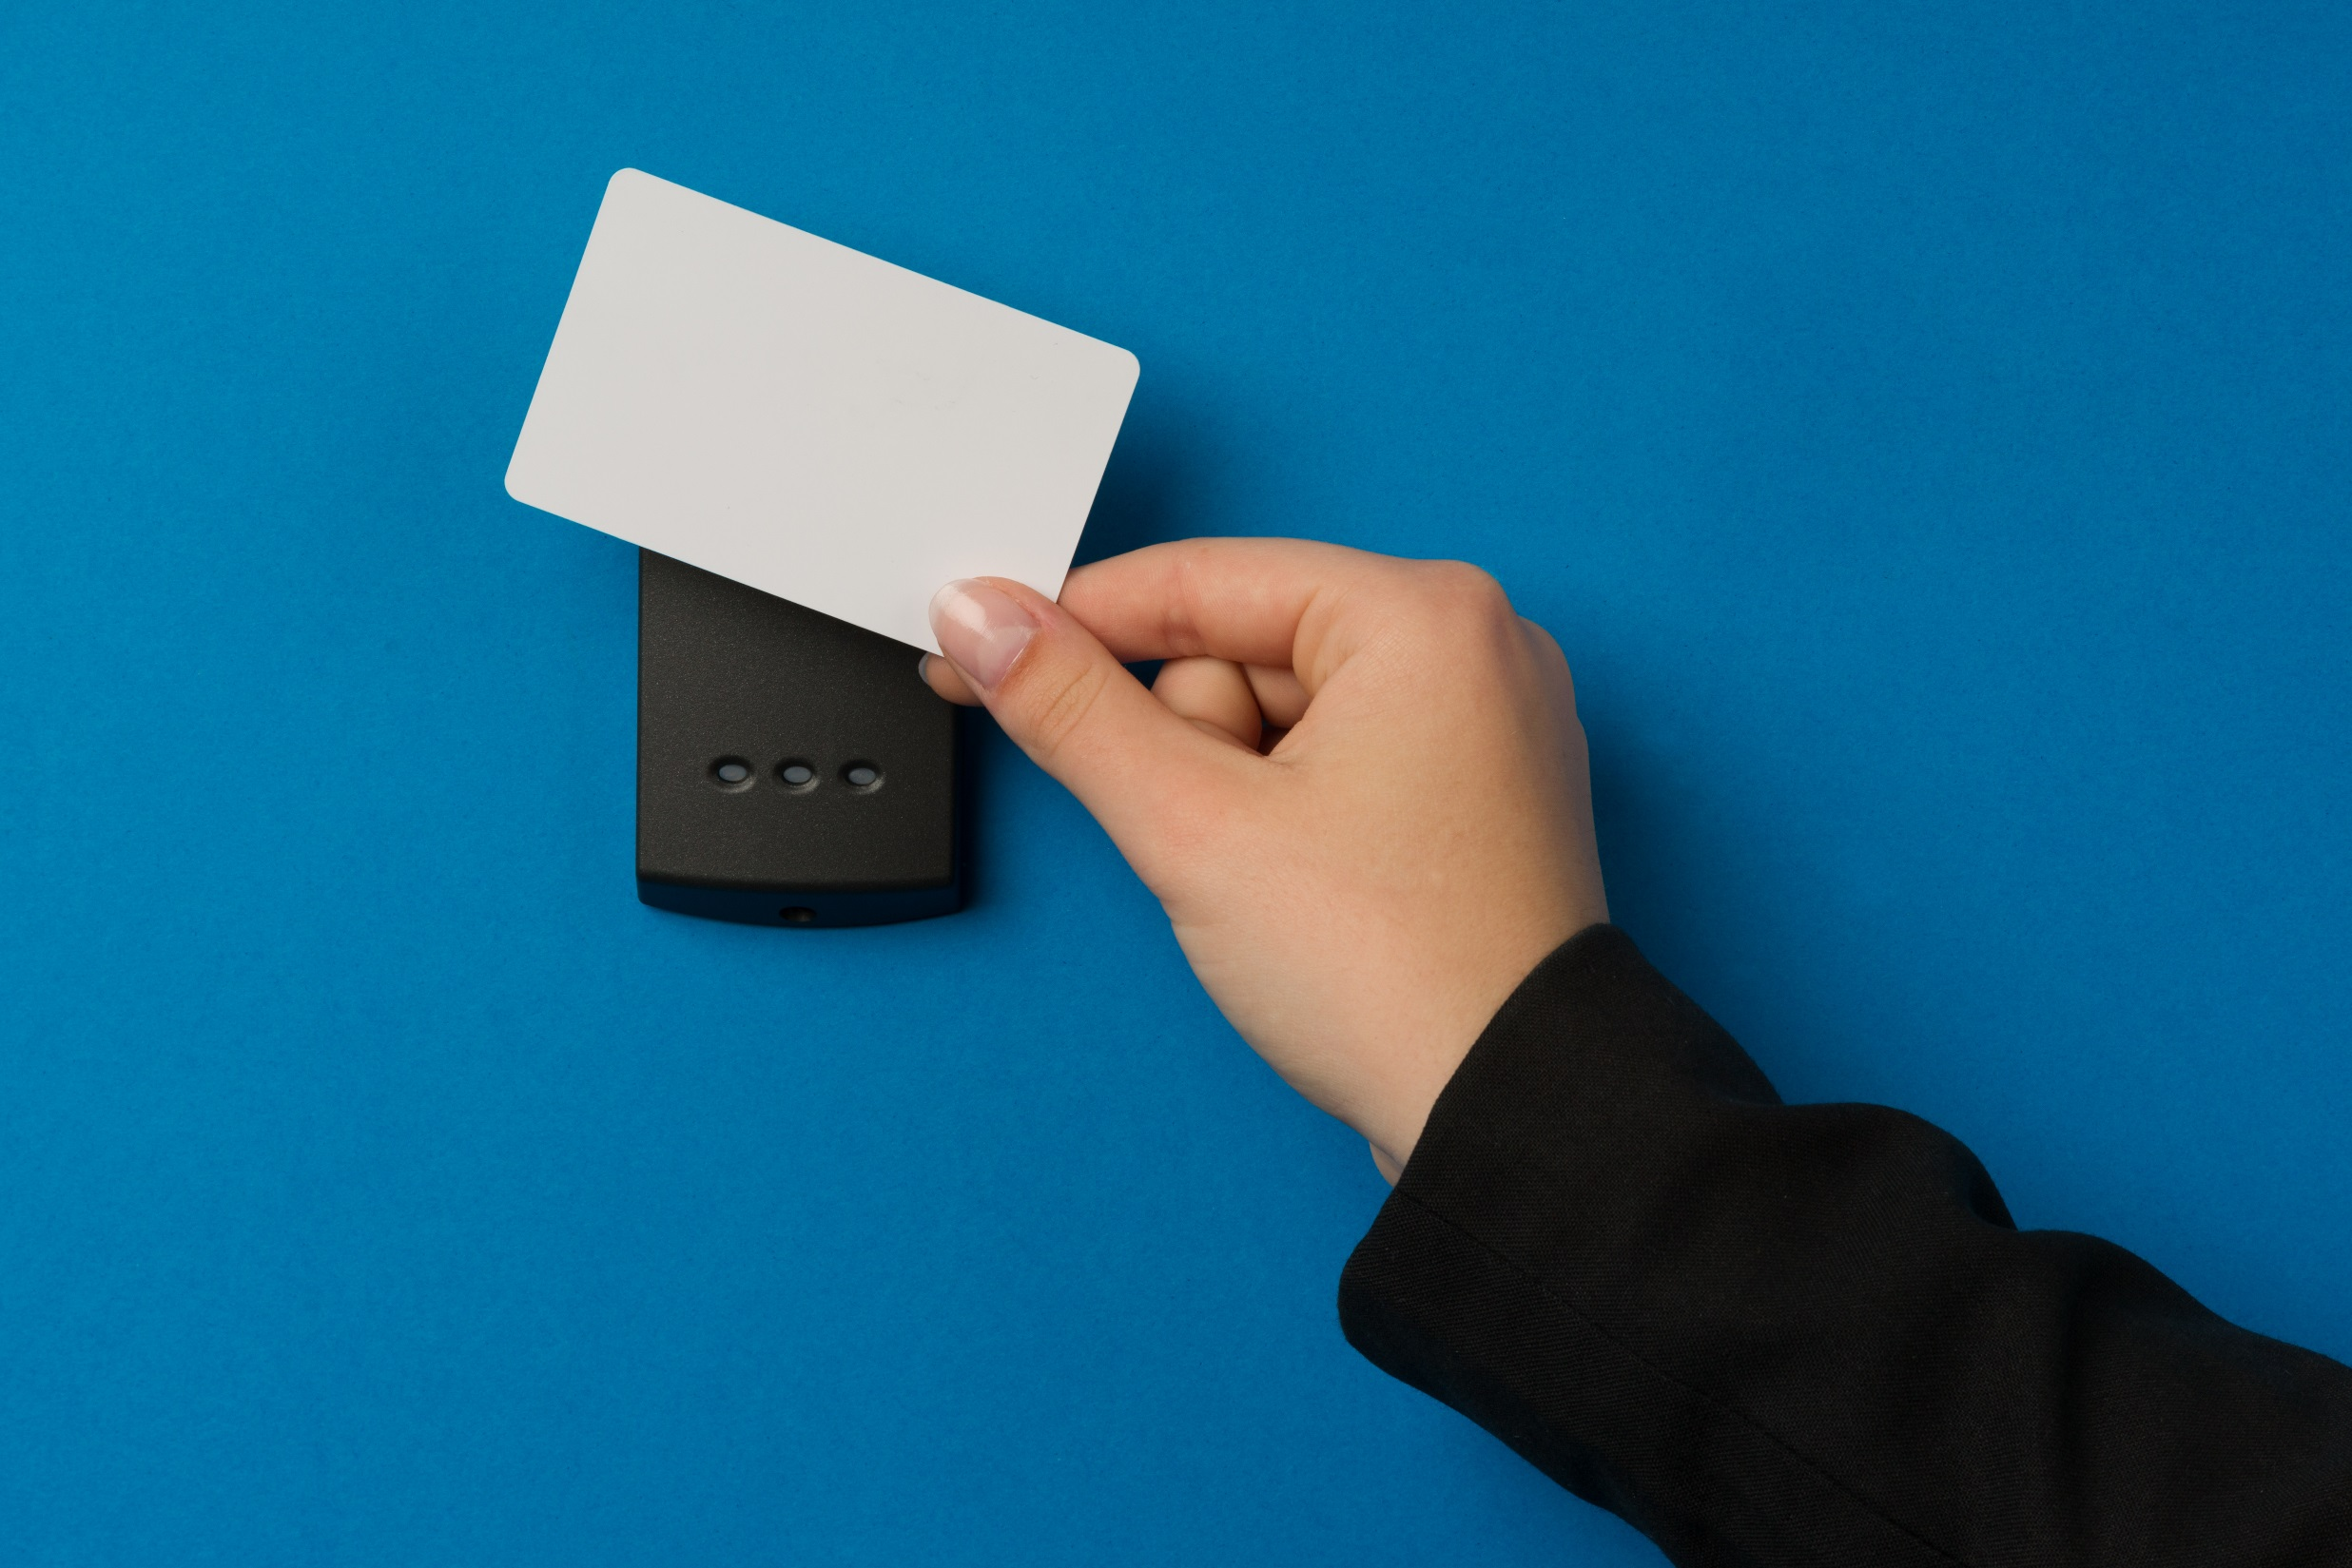
Access Control

Slide 3


Slide 4
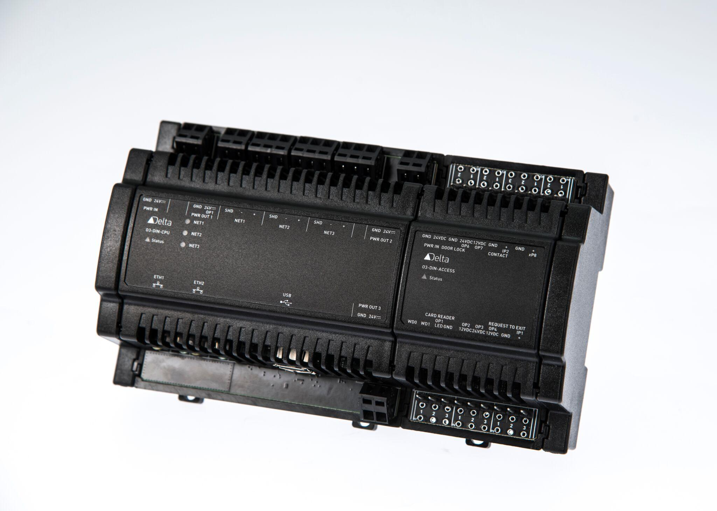
O3 ACCESS
O3-DIN access control module
Complete Access Control System solution includes:
O3-DIN-CPU firmware
enteliWEB
eSYNC
Access specific dashboards

Slide 5
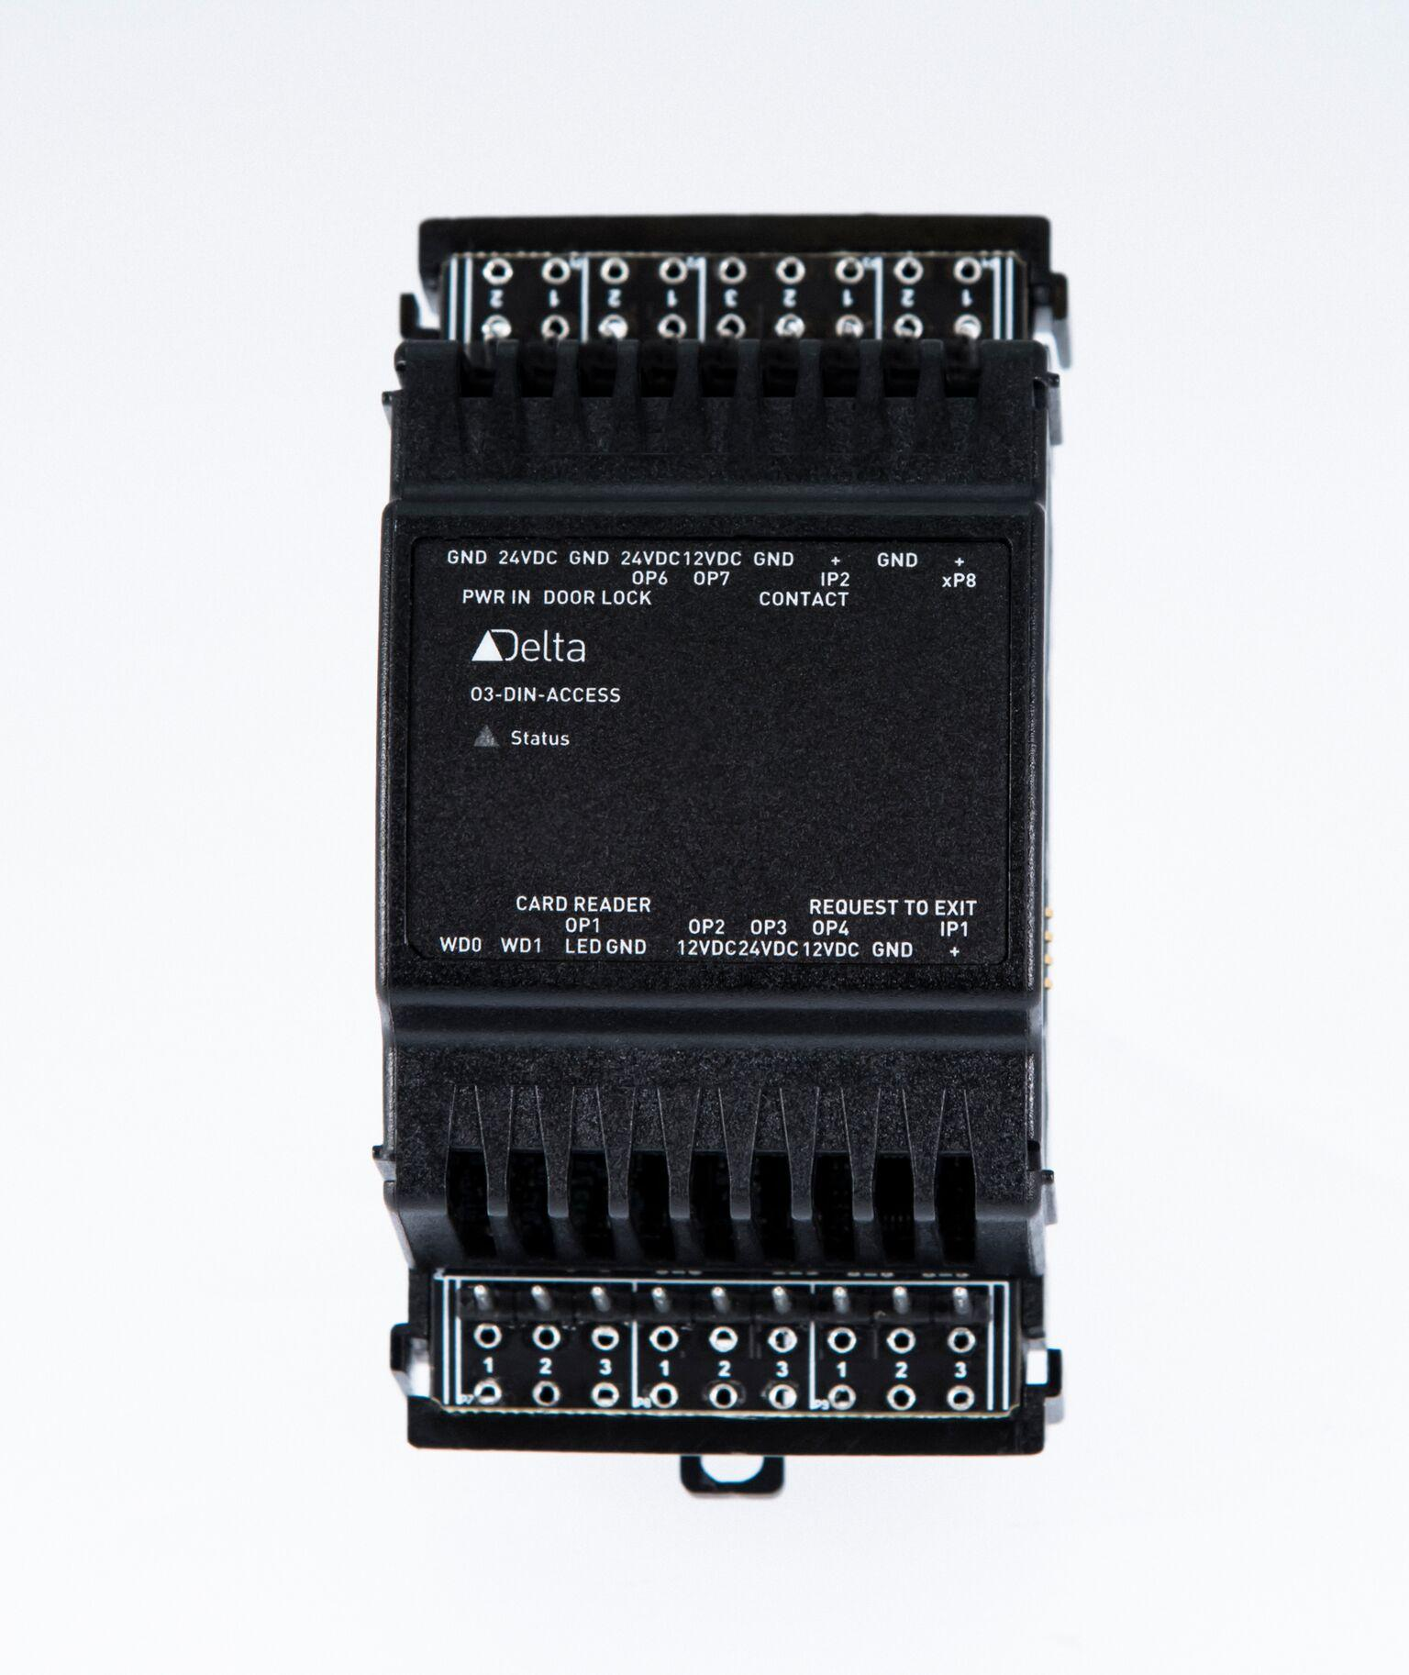
O3-DIN-ACCESS
Provides the IO for access control for a typical single door / credential reader
IO specific to access control application
wiegand input
supervised circuits
door lock outputs
No processing in the module, O3-DIN-CPU does control
IO focused firmware with higher reliability, allows O3-DIN-CPU to add on formats & functionality

Slide 6
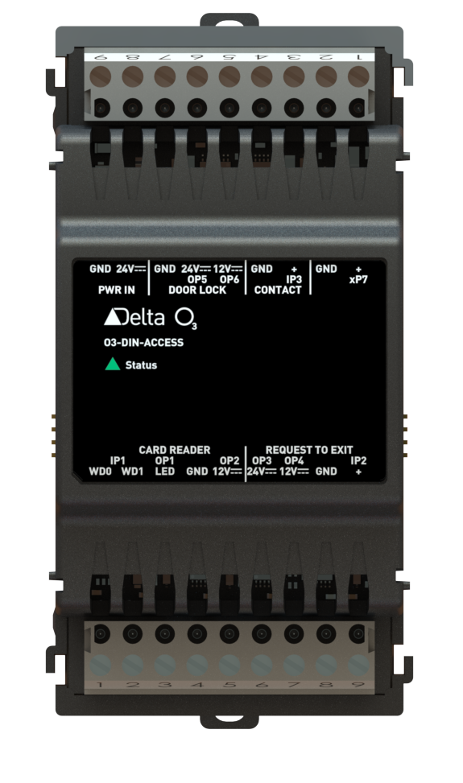
O3-DIN-ACCESS Module
Power in
Door
contact
Door
lock
Universal
point
IO interface for a typical single door / credential reader
IO specific to access control application
Wiegand input with LED output
26 bit
37 bit
37 bit facility
Simple 32
Custom (V4.9 firmware)
Supervised input circuits - Door Contact and RTE
Door lock outputs
12V/24V power output
Additional Universal IO - Software configurable
Supports multi-format reader from one input interface
Card reader
REX

Slide 7
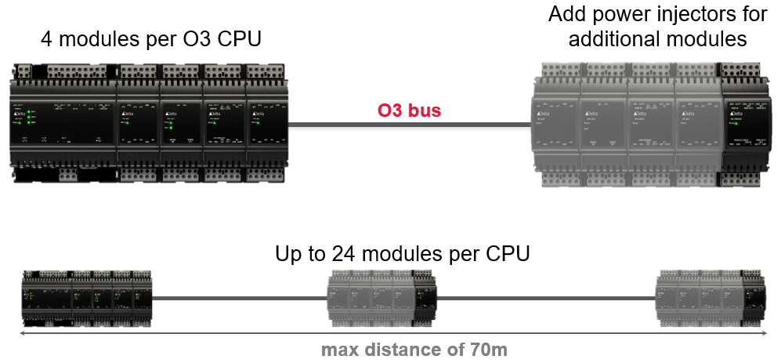
Architecture

Slide 8
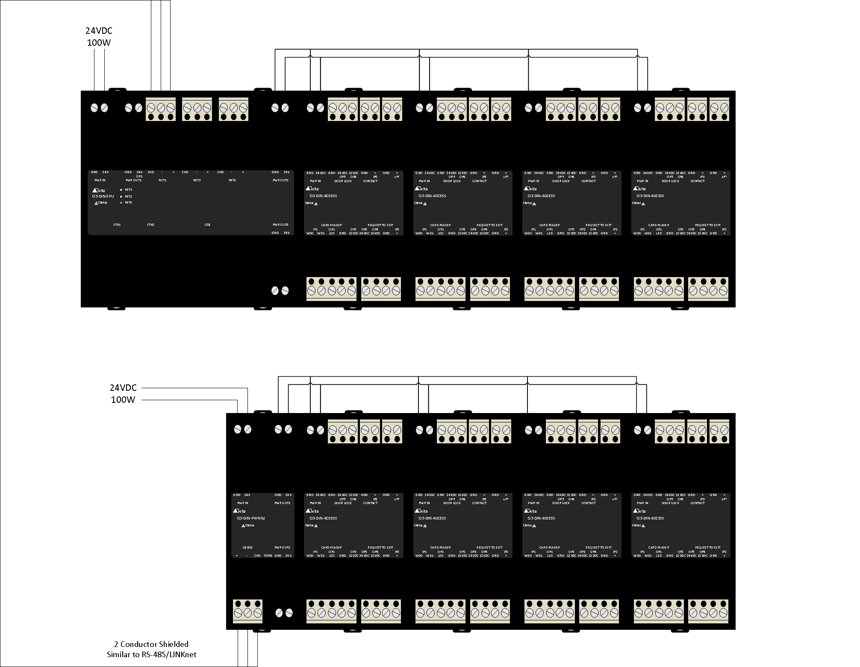
Typical module 15W
~75W Total

Slide 9
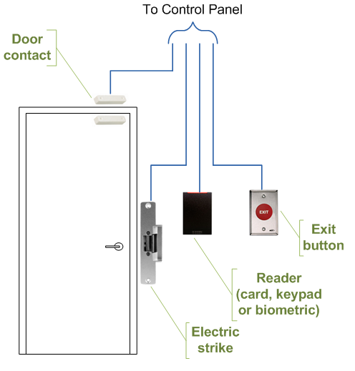
Application
Typical Single Direction Door
1 - O3-DIN-ACCESS with 12/24 electric strike, card reader, door contact, and 12/24 request to exit device
Single Direction Door with holder
1 - O3-DIN-ACCESS with 12/24 electric strike, card reader, door contact, and 12/24 request to exit device, and 12/24VDC door holder

Slide 10
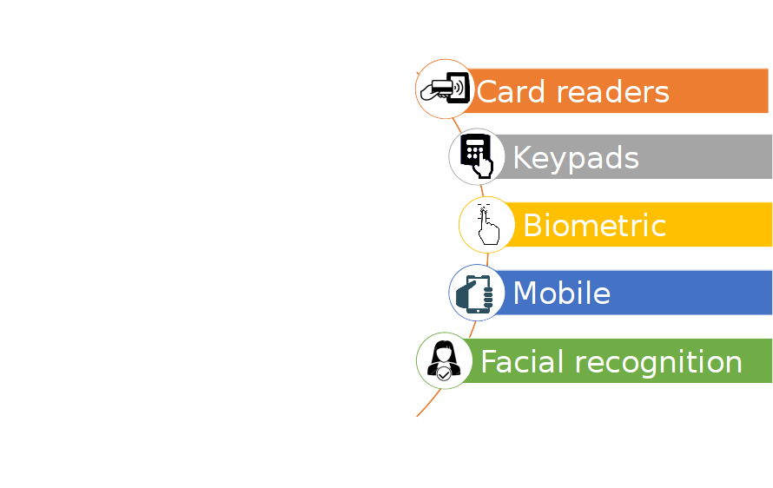
Reader Types
Support multi format upto 200 bits on wiegand port i.e. 26 and 37 bit
Formats are in O3-DIN-CPU not the module so easy to add to formats as we go
Door lock response <250ms meeting Doherty Threshold of response (ADM was upto ~800ms)
Compact takes less space and space costs
Energy management enabled, power monitored and power supplies controlled to shed energy

Slide 11
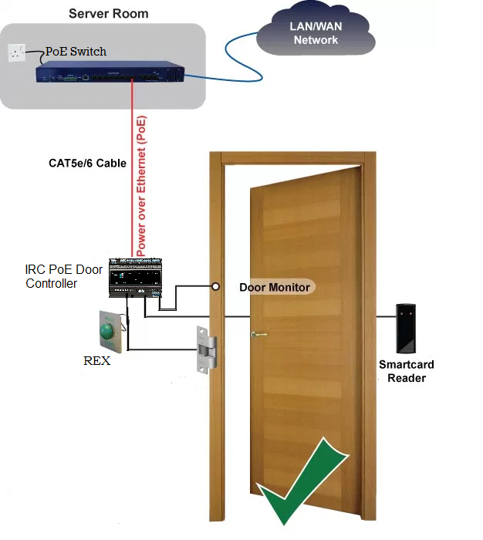
Where are we going?
PoE 2 Door Module Access
CPU and 2 door IO built in
Power all from PoE
Integrated single room controller / 4 door access controller
O3-DIN single room CPU
4 Module support for integration or 4 access controlled doors

Slide 12
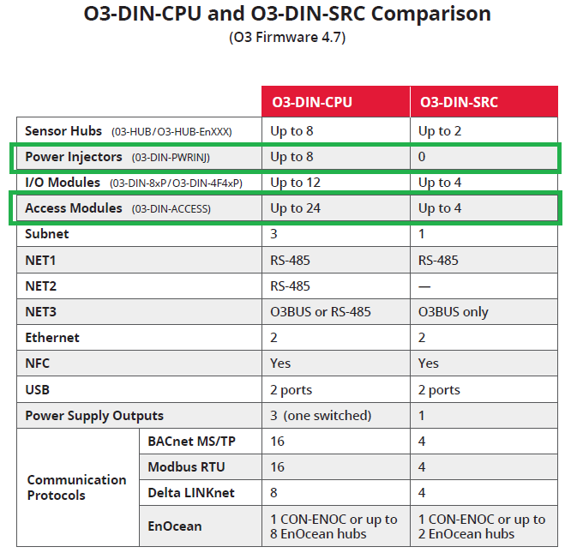

O3-DIN-CPU or O3-DIN-SRC?
O3-DIN-SRC
Centralized Layout up to 4 doors
O3-DIN-CPU
Centralized Layout up to 24 single direction doors and 5 power injectors
Distributed Layout up to 24 single direction doors and 8 power injectors

Slide 13
Software

Slide 14
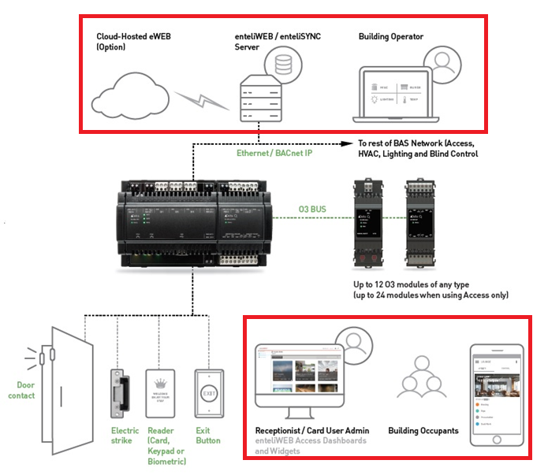
O3 Access System
Software
enteliSYNC
enteliWEB Access Dashboards

Slide 15
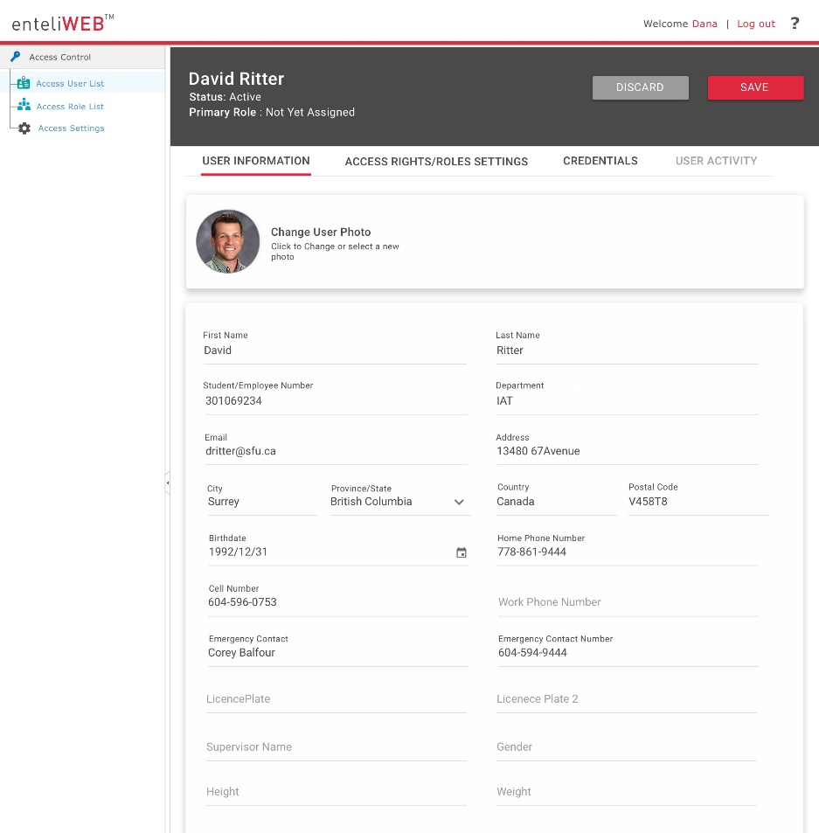
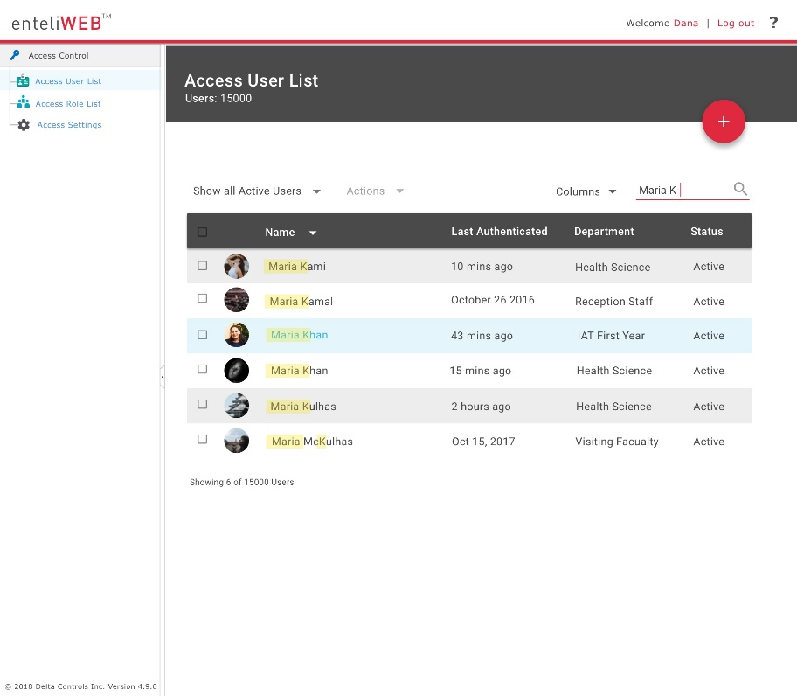
enteliWEB Access Dashboards
Single-seat management software
Intuitive dashboards for user enrollment
Role based permissions for different users
Customizable extended access user information
GDPR compliant
Visualizations via widgets reporting live data
Customizable access activity report
Virtual Enrollment Reader

Slide 16
enteliSYNC
Central Database – Synchronization engine,
Multi-Site functionality
Triggered by access dashboard
Virtual Enrollment – allows any card reader in the system to act like an enrollment reader
Event log – for V4 reporting

Slide 17
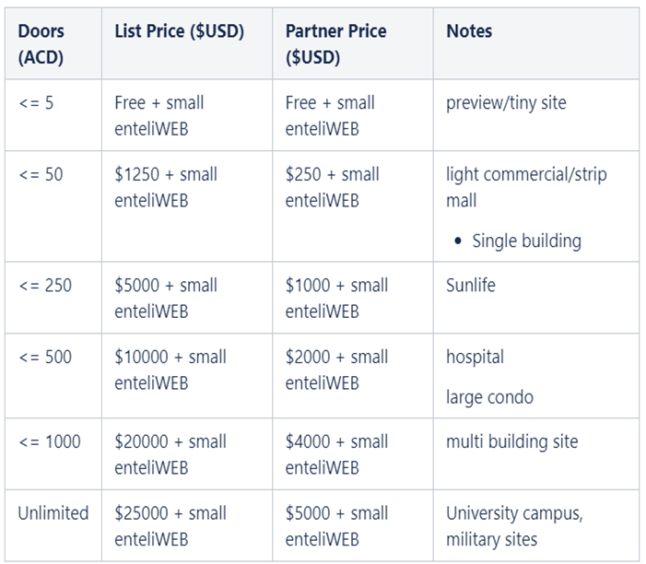
O3 Access Dashboards Licensing Model
Based on number of doors
Access IO wont be counted towards eWEB licensing
Subscription 7.5% annually – just like eWEB
Grace period of 30 days if door limit exceeded – dashboard will be disabled
After 30 days grace period if door limit is within limit – dashboard continues to work
Notes:
List price
eSYNC free
LPM model
eWEB license is required. Smallest would be fine

