Slide 1
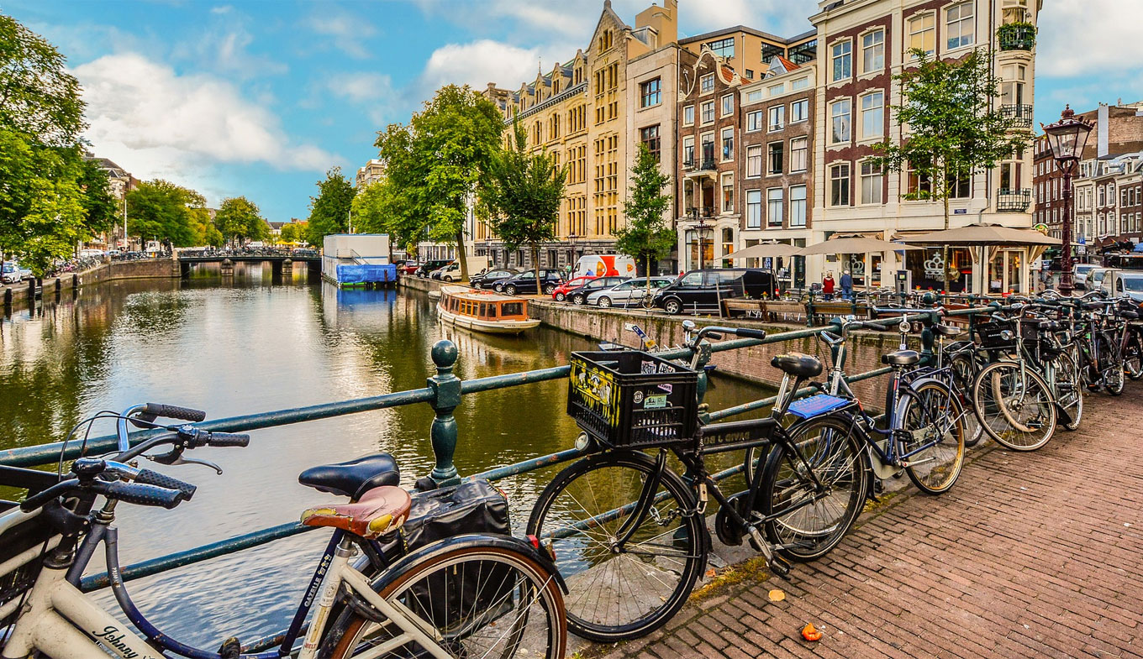
2019 European Seminar – Amsterdam, Netherlands
13:30 Welcome & Introduction
13:50 Regional Update
14:15 Product Roadmap
15:00 Break
15:30 O3-HUB 2.0
16:00 IoT & Cloud Ingestion
16:30 IoT Firmware (V4.9)
16:50 Tridium Integration
17:10 Open Mike #1
19:00 Networking Reception
20:00 Dinner
Agenda – Day 1

Slide 2
Welcome

Slide 3


George Wylie
OEM BDM Europe

Slide 4

New Terminology
VMS: Video Management Software
NVR: Network Video Recorder
VAST2: refers to Vivotek video management software (VMS)

Slide 5

VAST 2 Integration – enteliWEB 4.15
Vision
Expand our O3 Access solution with surveillance integration and video management
Do it right. | deltacontrols.com

Slide 6
Unique Selling Points (USPs)
Integration - Single seat management software for all control domains
Customizable and flexible
All Vivotek products available for purchase at DCI
Do it right. | deltacontrols.com

Slide 7

Notes:
700 employes, 137m revenue US dollars

Slide 8
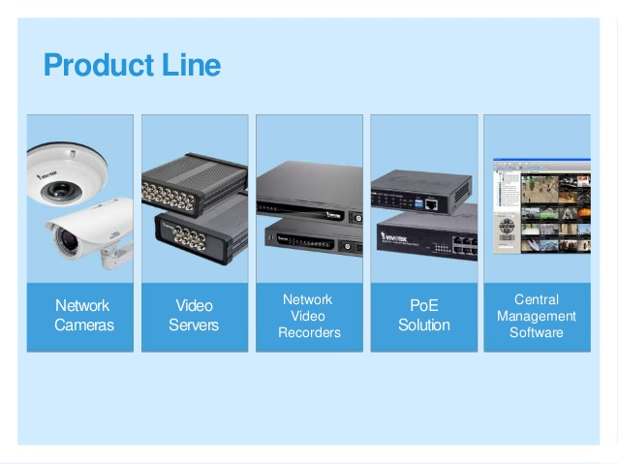
Notes:
Video servers, mpeg-4, mjpeg, rack mount desk mount, up to 24 channel.
NVRS – UP TO 16 channel, record monitor data online, vast and I view supported.
POE – unmanaged and managed poe switches industrial poe, daisy chained ip cameras

Slide 9
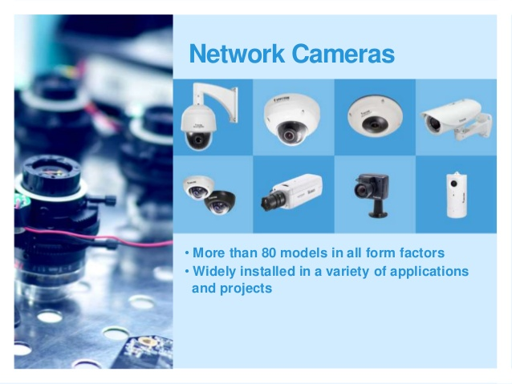
Notes:
Camera types and solutions – panoramic fish eye cameras, full HD ptz with 30x zoom, anti vandal domes for lifts and transportation and for social housing, IP67 strong bullet traffic ready, mini domes,

Slide 10
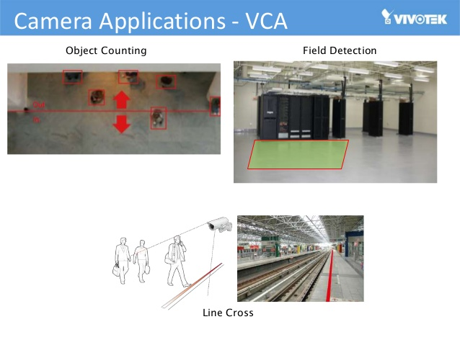

Slide 11
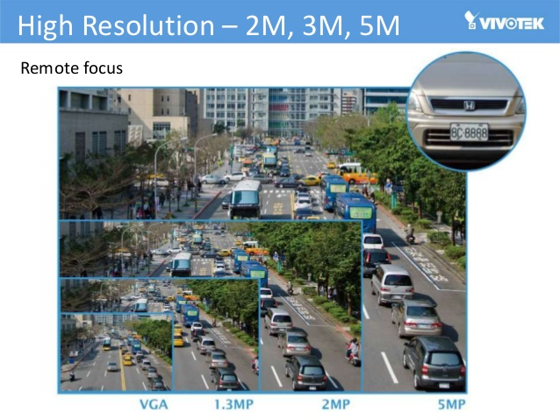

Slide 12
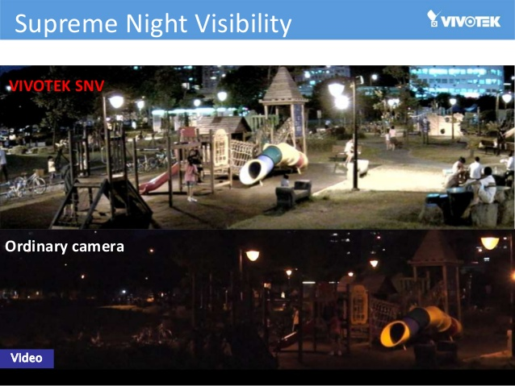

Slide 13
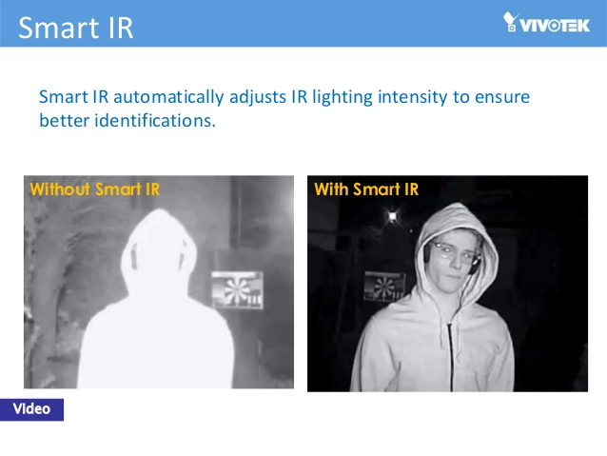

Slide 14
What is VAST 2?
Vivotek Video Management software
Vast 2: Latest Version of their release
Available free; download from Vivotek website: https://www.vivotek.com/vast2#downloads
No license needed for up to 32 Vivotek cameras
Notes:
VIVOTEK's VAST is an intuitive professional video/central management software designed for managing all VIVOTEK IP surveillance products. Download and install VAST 2 Server, Assign IP address to your NVRs and cameras, Add your NVRs and Cameras to the VAST2 server

Slide 15
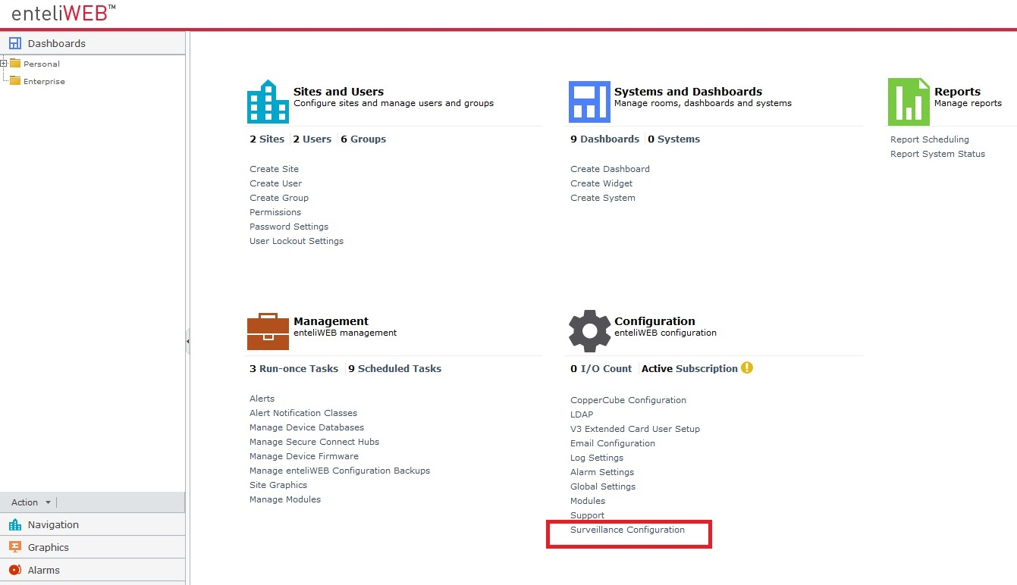
Setup VAST2 Server

Slide 16
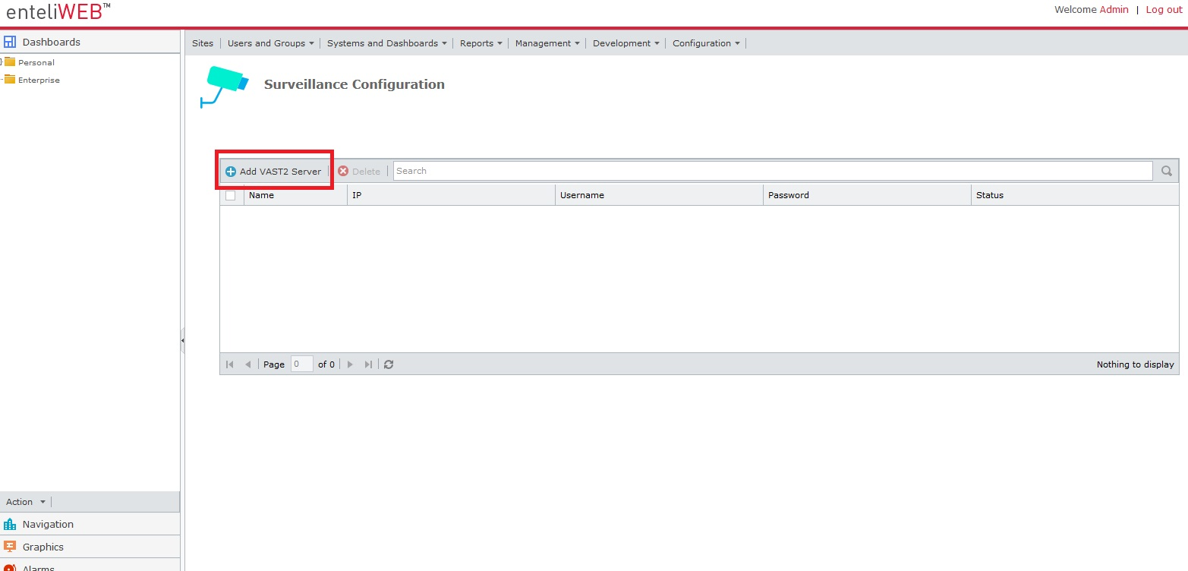
Setup VAST2 Server

Slide 17
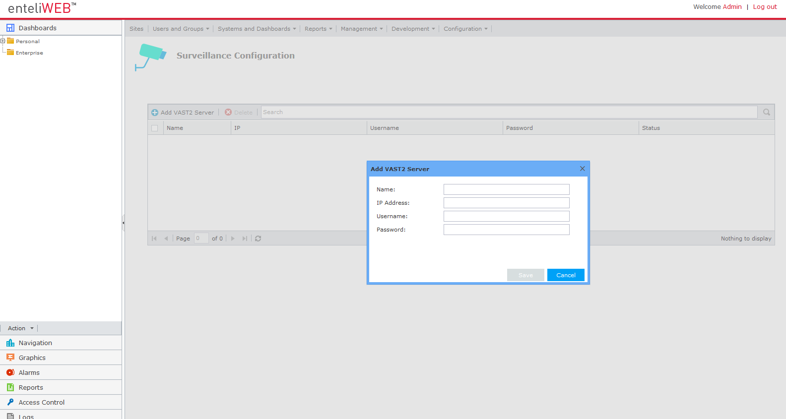
Setup VAST2 Server

Slide 18
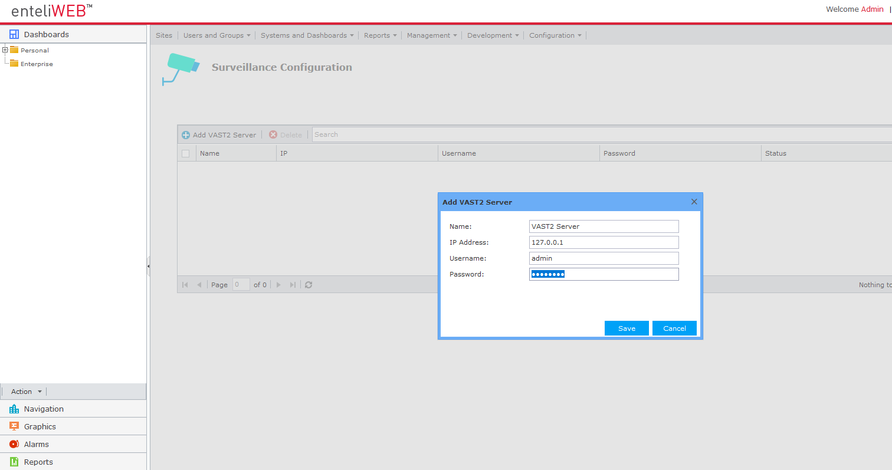
Setup VAST2 Server

Slide 19
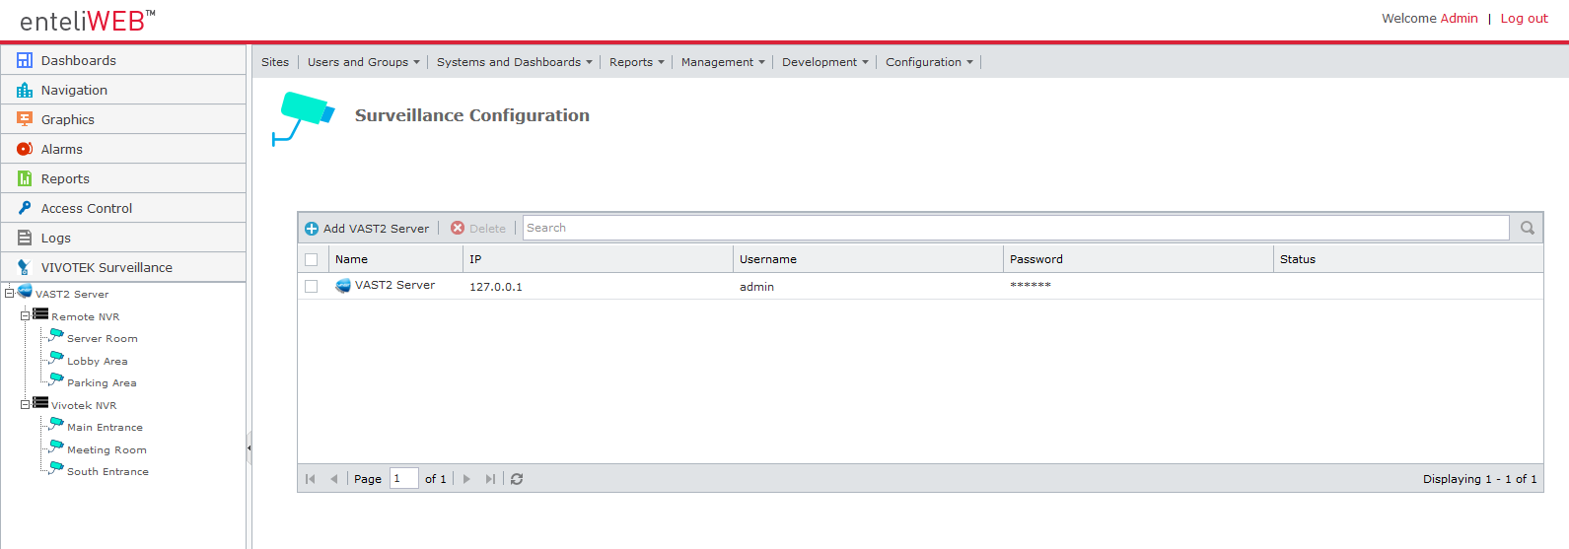
Set up VAST2 Server

Slide 20
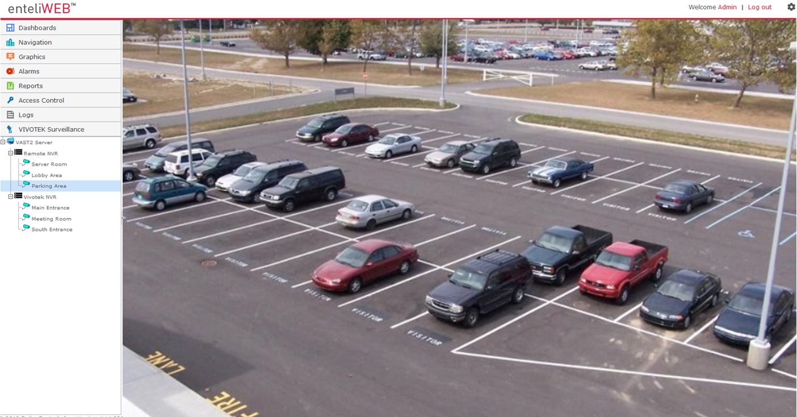
View Camera Live Video

Slide 21
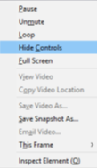
Control Camera functions

Slide 22
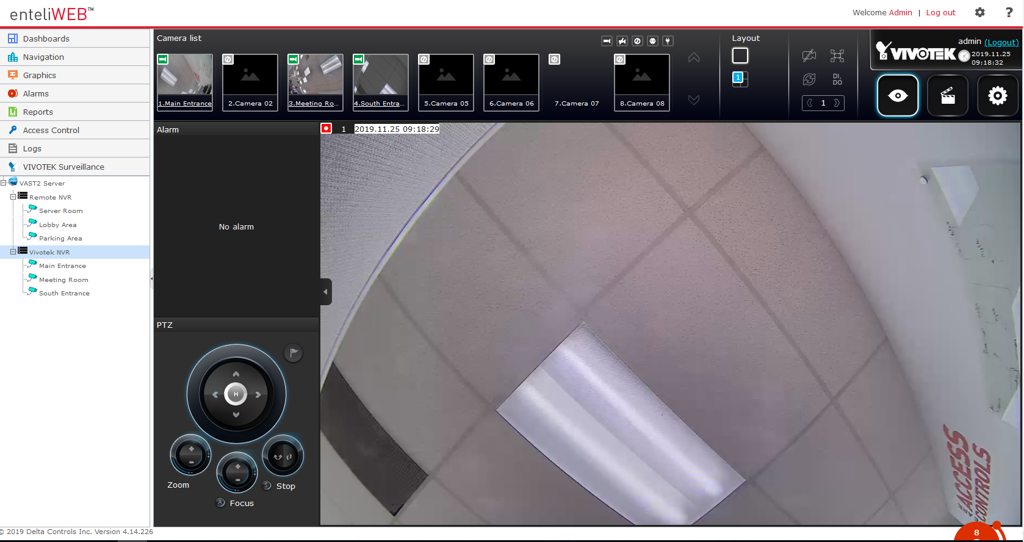
NVR Setup Page

Slide 23
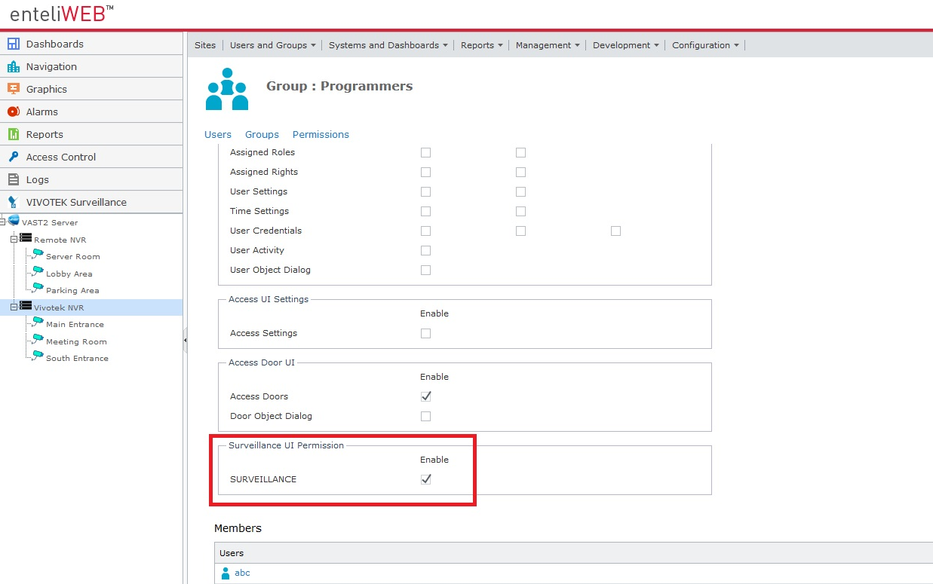
Grant Access to Surveillance

Slide 24
European Seminar – Amsterdam 2019
from 06:30 Breakfast at your convenience
09:00 Access Control
09:30 Vivotek
09:50 GRMP
10:00 Global Conference 2020
10:15 Break
10:45 Apollo House
11:15 Trade Shows 2020
11:35 Training Schedule
11:55 Open Mike #2
12:15 Summary & Close
Agenda – Day 2

