Slide 1


Customer Services
NEW! Delta
Notes:
Thank the guests

Slide 2

fh
GLOBAL CUSTOMER CARE TEAM
PAS Team
eWEB SaaS
Enterprise Integration
Non HVAC Partners
Corporate Account Contracting
Director of Global Inside Sales
OEM /OBM /ODM
Kurt Graves
ORDERS ADMINSTRATION
FIELD DEVICES (Non-DCI)
RMA & LICENSING
COMMERCIAL /
SALES COORDINATION
TECHNICAL SALES SUPPORT
PARTNER CHANNEL
OEM
CORPORATE ACCOUNTS
Customer Service Reps
Nicci Bly Freund
Leanne Van Hatten
Tricia Lawrence
Field Devices Coordinator
RMA Administrator
Commercial Lead
Lead Sales Engineer
Lead Sales Engineer
Sales Engineer
Elise Kosturas
Samantha Wright
Joe Williamson
Jeff Chretien
New Hire
Deborah Kucey
Sales Engineer
Shirley Xiang
RSM
&
BDM
Teams
System Partners
Corporate
Accounts
All Customer Accounts
OEM
Notes:
Customer care team overview
We have a central team that looks after ALL orders and for commercial sales support
Technical sales support is streamlined into our three customer segments with sales engineers dedicated to each channels. They are also cross trained
At the same time we support our external sale team globally
And we also work quote PAS services, which range from API integrations, to turnkey projects, as well engineering & programming for OEM products

Slide 3


Customer Service Initiative

Slide 4
Customer Service Initiative
Selling DE and other non-DCI products is strategically important to revenue growth: a.k.a. Increasing DCI’s Share of the Partner “Wallet” initiative
Key to the success of selling non-DCI products where partner have a choice of where to buy same or equivalent:
DE products
Field devices
Tridium
Also applies to DCI product sales since commoditized BMS products are becoming increasingly accessible

Slide 5
WOW! Customer Service Initiative
Initiative
Integrating Customer Service and Inside Sales Operations into the same workspace
Outcome

Slide 6
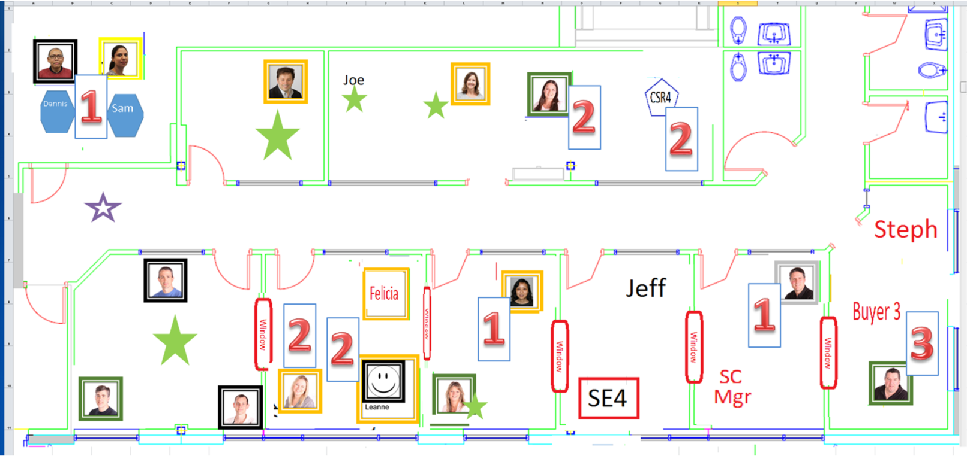
Integrated Workspace Sales Operations & Production
Inside Sales Support
Orders Administration
Production scheduling
Supply Chain
Purchasing
Material Handling
Logistics

Slide 7










Global Customer Care Team
ORDERS ADMINSTRATION
Director of Global Inside Sales
Kurt Graves
Customer Service Representatives
Nicci Bly Freund
Leanne Van Hatten
Tricia Lawrence
TECHNICAL SALES SUPPORT
PARTNER CHANNEL
Lead Sales Engineer
Joe Williamson
All Customers + Products
COMMERCIAL +
SALES COORDINATION
Sales Engineer
Shirley Xiang
FIELD DEVICES (Non-DCI)
OEM
Field Devices Coordinator
Commercial Lead
Lead Sales Engineer
Elise Kosturas
Deborah Kucey
Jeff Chretien
Vendor Coordination
Owns Service Level Agreement
Contracts / CRM / Reports / Pricing
Commercial Queries
Commercial Onboarding
Sales Team ”Quarterback”
CORPORATE ACCOUNTS
Sales Engineer
New Hire
RMA & LICENSING
Proposals & Quotations
Technical Queries
Specification reviews
Technical Onboarding
RMA Administrator
Samantha Wright
RMA Processing
Product Licensing / Renewals

Slide 8
WOW! Customer Service Initiative
Initiative
Integrating Customer Service and Inside Sales Operations into the same workspace
Outcome
Instant communication to handle customer queries and issues -> faster + more insightful customer experience

Slide 9
WOW! Customer Service Initiative
Initiative
Integrating Customer Service and Inside Sales Operations into the same workspace
New Online Ordering Site
Outcome
Instant communication to handle customer queries and issues -> faster + more insightful customer experience

Slide 10
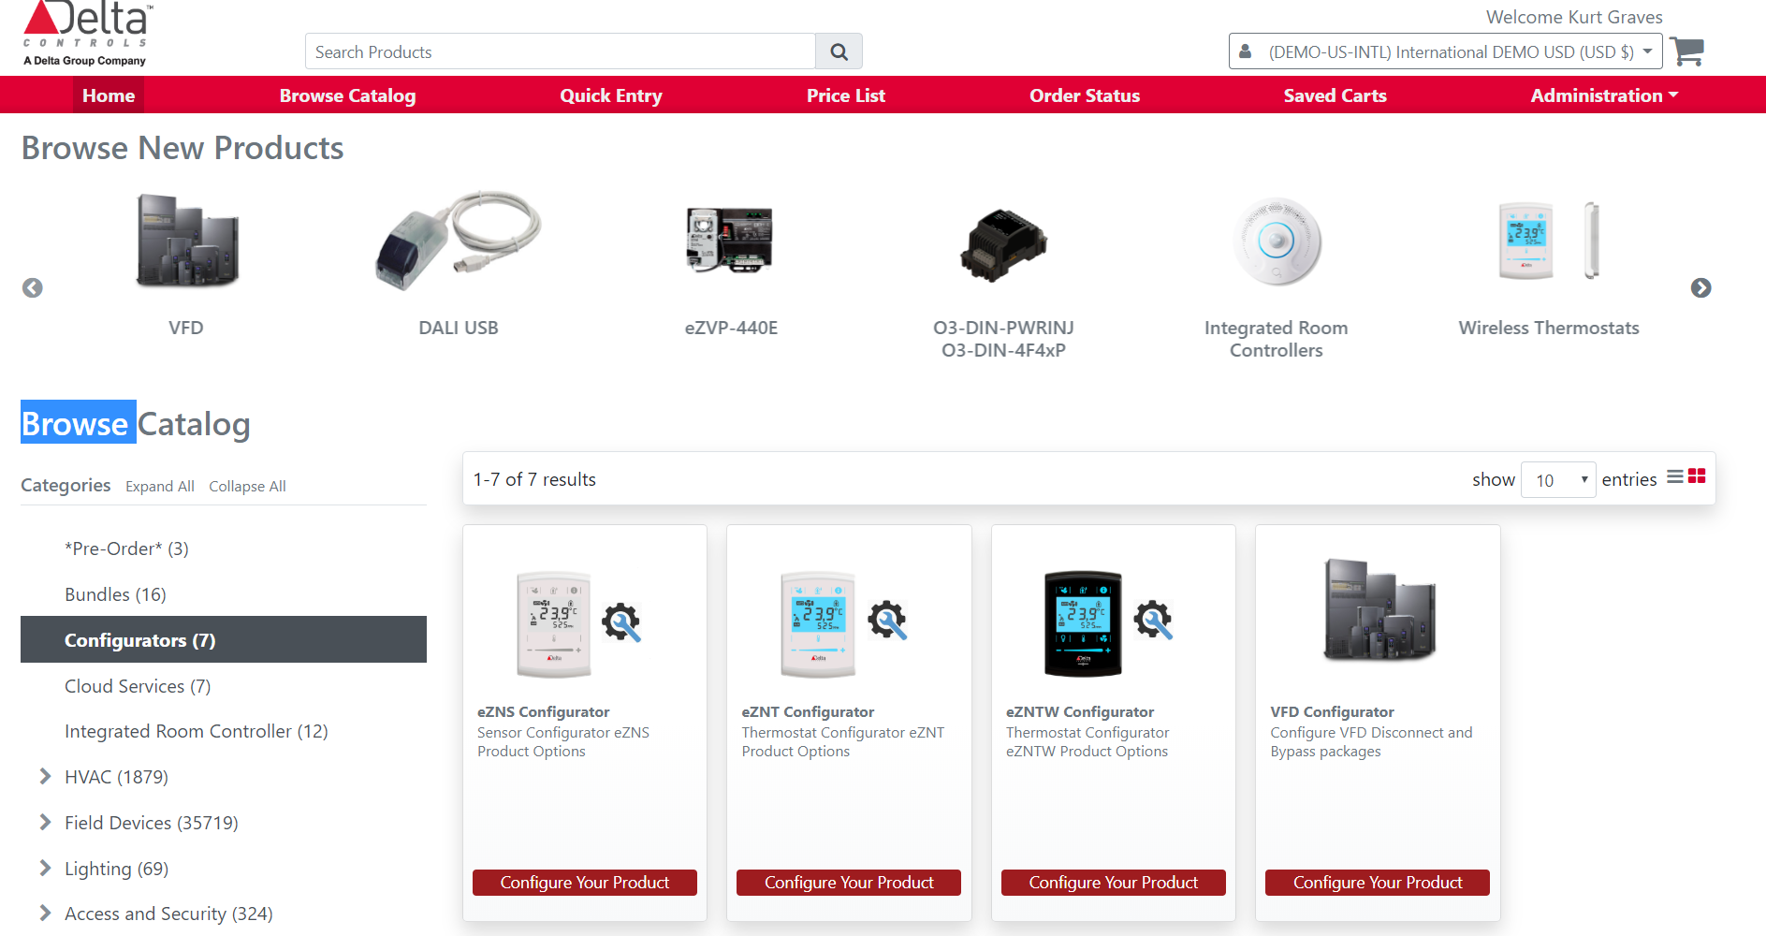
Online Ordering Site
Notes:
Faster & Richer Customer Experience aimed at driving more orders to be placed ONLINE

Slide 11
WOW! Customer Service Initiative
Initiative
Integrating Customer Service and Inside Sales Operations into the same workspace
New Online Ordering Site
Outcome
Instant communication to handle customer queries and issues -> faster + more insightful customer experience
Faster & Richer Customer Experience aimed at driving more orders to be placed ONLINE

Slide 12
WOW! Customer Service Initiative
Initiative
Integrating Customer Service and Inside Sales Operations into the same workspace
New Online Ordering Site
Re-examine workflow processes and structure to reduce interactions and eliminate bottle necks & redundancies
Outcome
Instant communication to handle customer queries and issues -> faster + more insightful customer experience
Faster & Richer Customer Experience aimed at driving more orders to be placed ONLINE

Slide 13
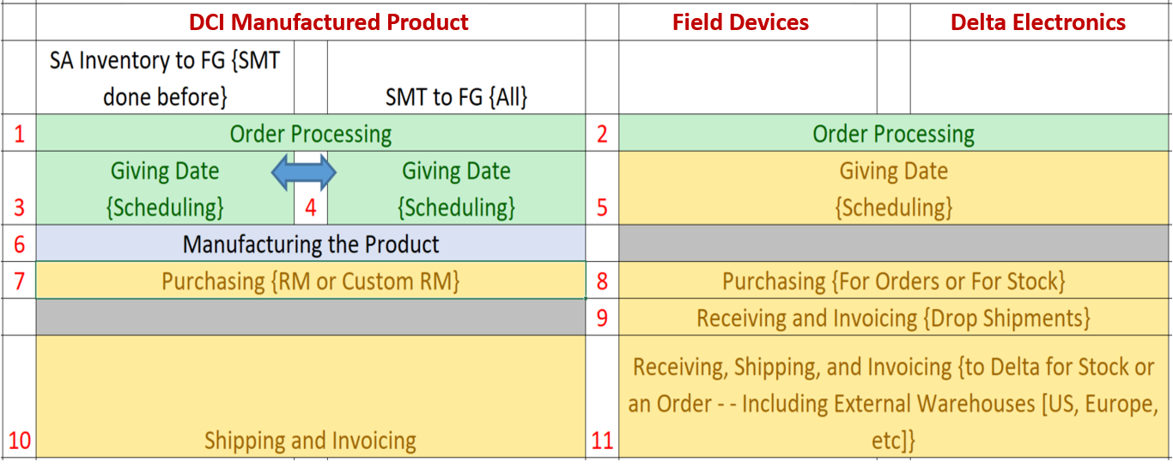
Review of Processes
Notes:
Re-examine workflow processes and structure to reduce interactions and eliminate bottle necks & redundancies
Faster & more efficient workflows, minimized order processing & logistics error

Slide 14
WOW! Customer Service Initiative
Initiative
Integrating Customer Service and Inside Sales Operations into the same workspace
New Online Ordering Site
Re-examine workflow processes and structure to reduce interactions and eliminate bottle necks & redundancies
Outcome
Instant communication to handle customer queries and issues -> faster + more insightful customer experience
Faster & Richer Customer Experience aimed at driving more orders to be placed ONLINE
Faster & more efficient workflows, minimized order processing & logistics error

Slide 15
WOW! Customer Service Initiative
Initiative
Integrating Customer Service and Inside Sales Operations into the same workspace
New Online Ordering Site
Re-examine workflow processes and structure to reduce interactions and eliminate bottle necks & redundancies
New role “Field Device Coordinator” created within Customer Care Team
Dedicated BUYER for non-DCI products
Outcome
Instant communication to handle customer queries and issues -> faster + more insightful customer experience
Faster & Richer Customer Experience aimed at driving more orders to be placed ONLINE
Faster & more efficient workflows, minimized order processing & logistics error

Slide 16
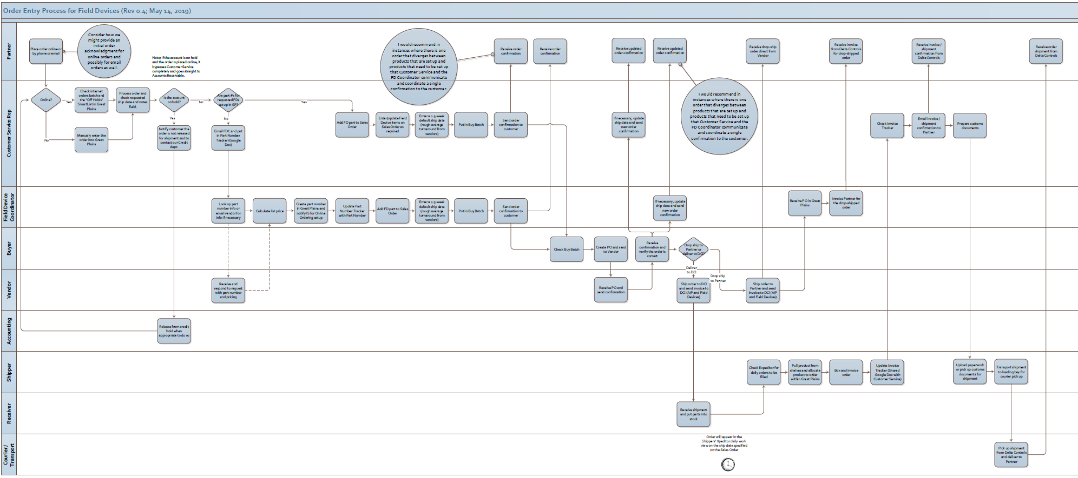
PARTNER
CUSTOMER SERVICE
FIELD DEVICE COORDINATOR
BUYER
FIELD DEVICE VENDOR
ACCOUNTING
SHIPPER
STREAMLINED WORKFLOW
- FIELD DEVICE ORDERS -
RECEIVER
COURIER / TRANSPORT
Notes:
New role “Field Device Coordinator” created within Customer Care Team
Dedicated BUYER for non-DCI products
Automated non-DCI product parts creation importing vendor portfolios “in bulk”
Ownership and resource dedication to service the non-DCI product “Partner Wallet Share” Program in response to the fast rising demand for Field Devices
More complete product offerings available in online order for any given vendor ( -> less ad hoc part # creations)

Slide 17
WOW! Customer Service Initiative
Initiative
Integrating Customer Service and Inside Sales Operations into the same workspace
New Online Ordering Site
Re-examine workflow processes and structure to reduce interactions and eliminate bottle necks & redundancies
New role “Field Device Coordinator” created within Customer Care Team
Dedicated BUYER for non-DCI products
Outcome
Instant communication to handle customer queries and issues -> faster + more insightful customer experience
Faster & Richer Customer Experience aimed at driving more orders to be placed ONLINE
Faster & more efficient workflows, minimized order processing & logistics error
Ownership and resource dedication to service the non-DCI product “Partner Wallet Share” Program in response to the fast rising demand for Field Devices

Slide 18
WOW! Customer Service Initiative
Initiative
Integrating Customer Service and Inside Sales Operations into the same workspace
New Online Ordering Site
Re-examine workflow processes and structure to reduce interactions and eliminate bottle necks & redundancies
New role “Field Device Coordinator” created within Customer Care Team
Dedicated BUYER for non-DCI products
Automated non-DCI product parts creation importing vendor portfolios “in bulk”
Outcome
Instant communication to handle customer queries and issues -> faster + more insightful customer experience
Faster & Richer Customer Experience aimed at driving more orders to be placed ONLINE
Faster & more efficient workflows, minimized order processing & logistics error
Ownership and resource dedication to service the non-DCI product “Partner Wallet Share” Program in response
to the fast rising demand for Field Devices
More complete product offerings available in online order for any given vendor ( -> less ad hoc part # creations)

Slide 19
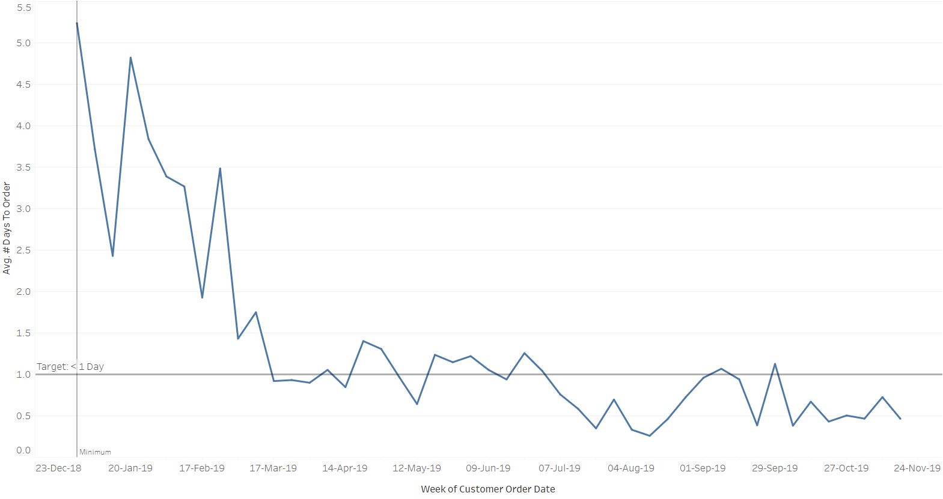
Field Devices Orders Turnaround

Slide 20
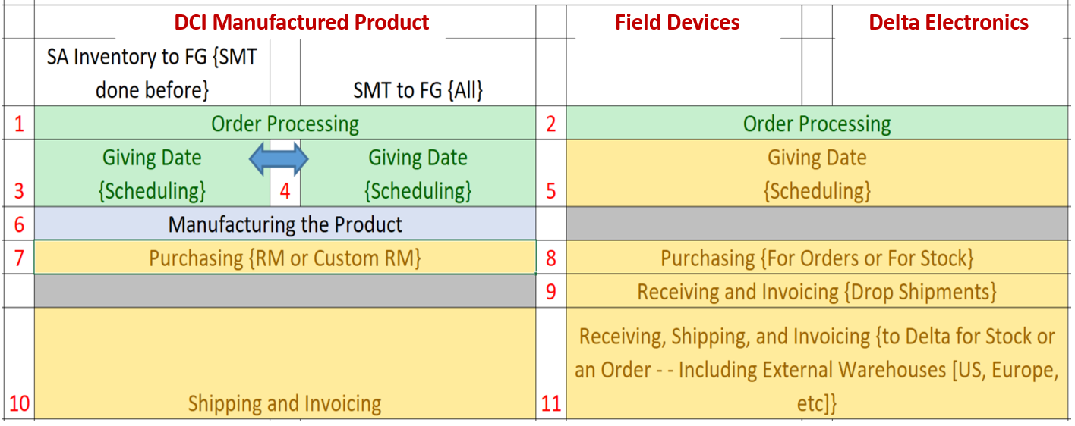
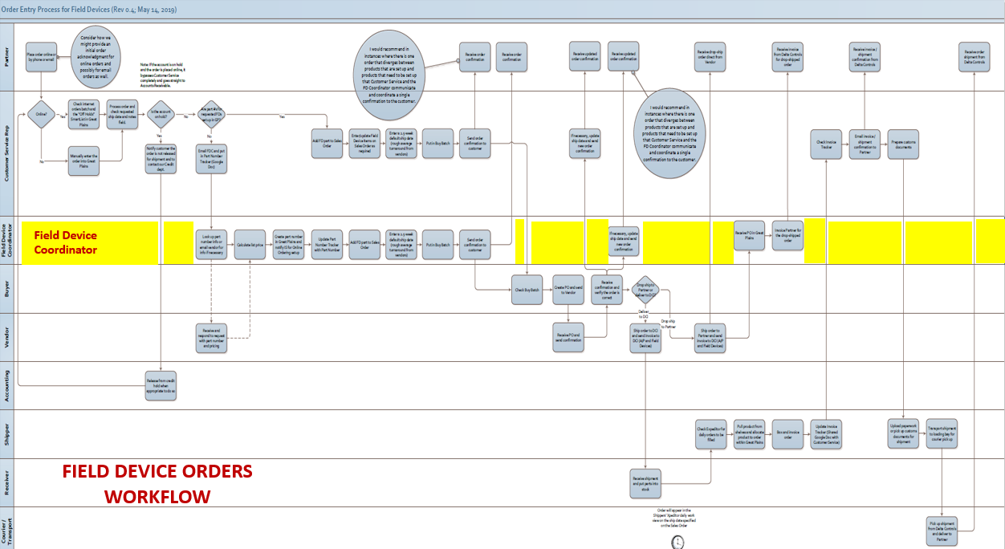
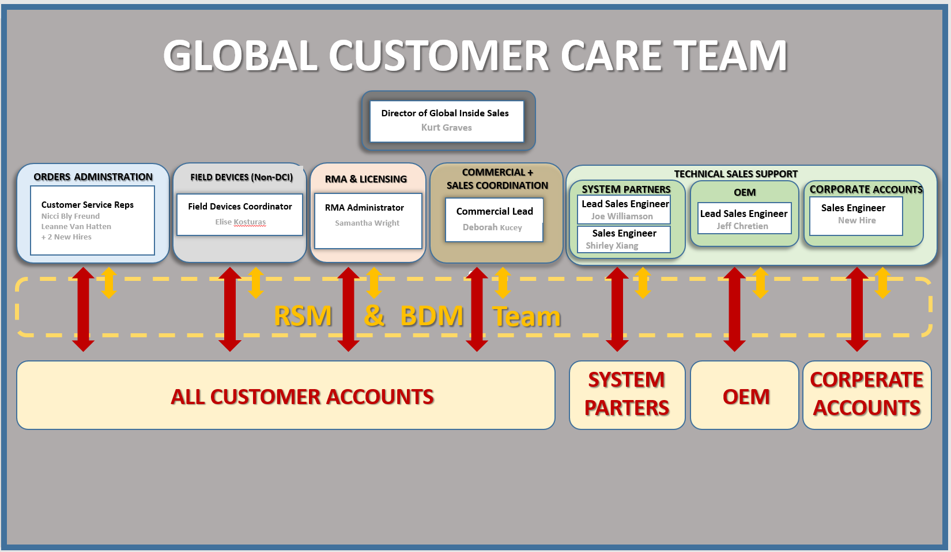
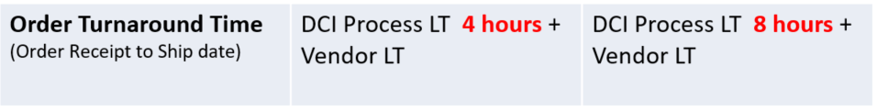
Customer SLA for Non-DCI Products
Phase 1 – Q4.2019
IS/CS Office Integration
New Online Ordering
Process Restructure
Streamlined Workflow
New Team Structure
+
+
+
+
 | Web Order | Non-Web Order
Order Confirmation | Immediate | 8 hours (with est. ship date)
Confirmation Update 1 | + 4 hours (with est. ship date) | + Vendor OC LT (if required)
Confirmation Update 2 | + Vendor OC LT (if required)
Order Turnaround Time (Order Receipt to Ship date) | DCI Process LT 4 hours + Vendor LT | DCI Process LT 8 hours + Vendor LT

Slide 21

WOW! Customer SLA
Phase 2 – Q1.2020
Dashboards & Reports
Dashboards & Reports for various Groups (Management, Buyers, Engineers, Sales, Accounting)
Purchase suggestions to optimize costs based on buying patterns/history (e.g. bulk, bundles,...)
What do other partners buy? E.g. Ranking of products per DCI and FD product category in North America
Faster SLA turnaround times (e.g. automated buying)
Advanced FIELD DEVICE search possibilities across multiple vendors, more selection
Data Analytics

Slide 22
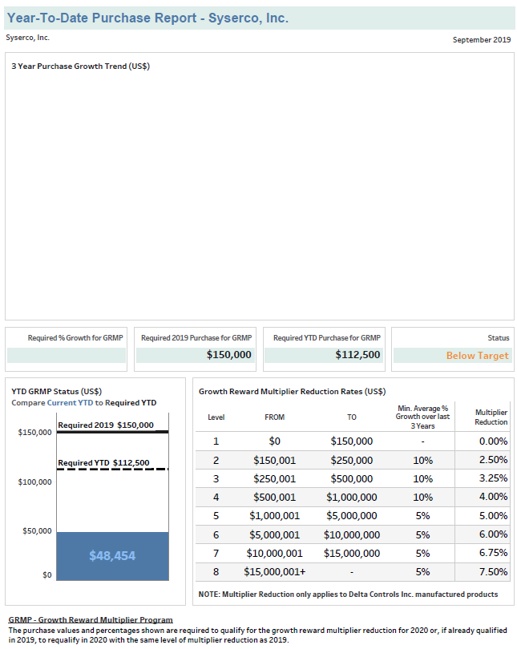
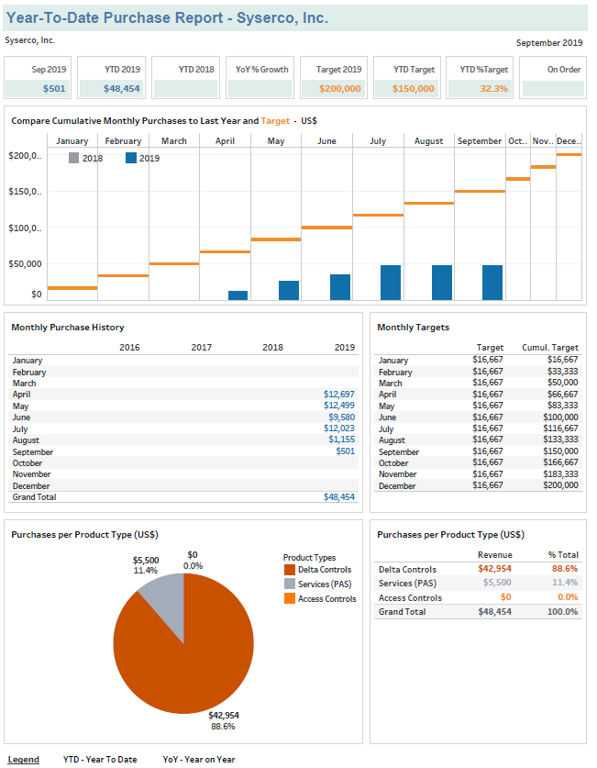
--- Page 1 ---
Purchase Summary YTD
--- Page 2 ---
GRMP Status YTD for 2020

Slide 23

Thank You

