Slide 1

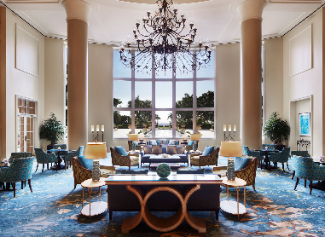
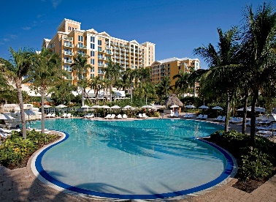
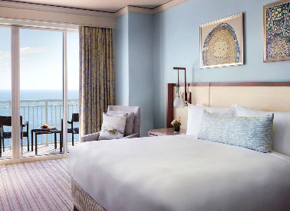
Delta Controls is excited to announce that our next Global Conference will be in Miami, Florida, May 27-29 2020!
We are holding the conference at the luxurious Ritz- Carlton Key Biscayne Hotel, secluded on a barrier island with shimmering gold sand and tropical views. This conference is your island escape, with ocean-view residences and suites, a renowned tennis center, a Caribbean-inspired resort spa, and Lightkeepers restaurant featuring Florida-sourced seafood.

