Slide 1

2019 European Seminar – Amsterdam, Netherlands

Slide 2
Trade Shows

Slide 3

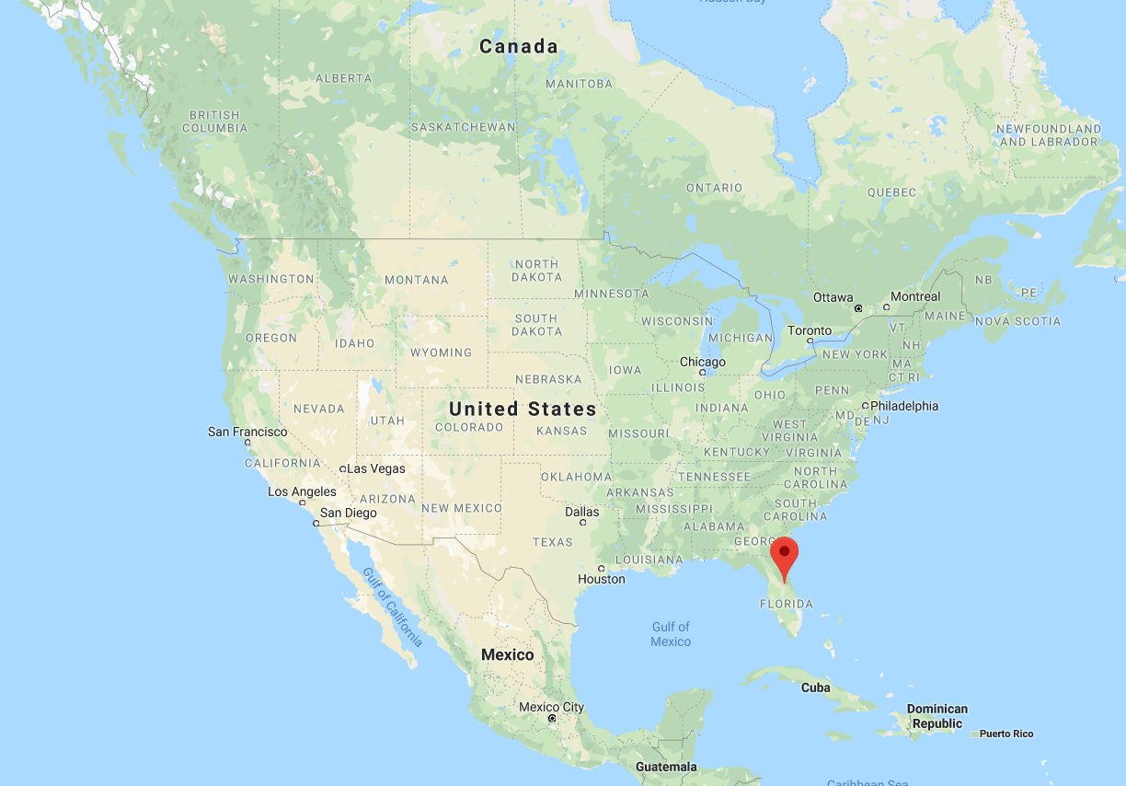

Slide 4
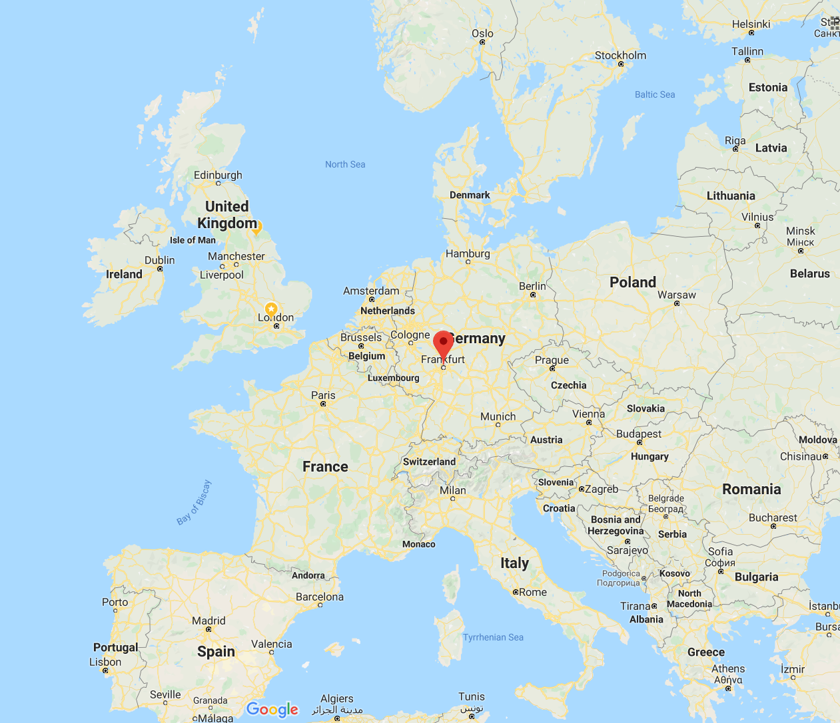


Slide 5

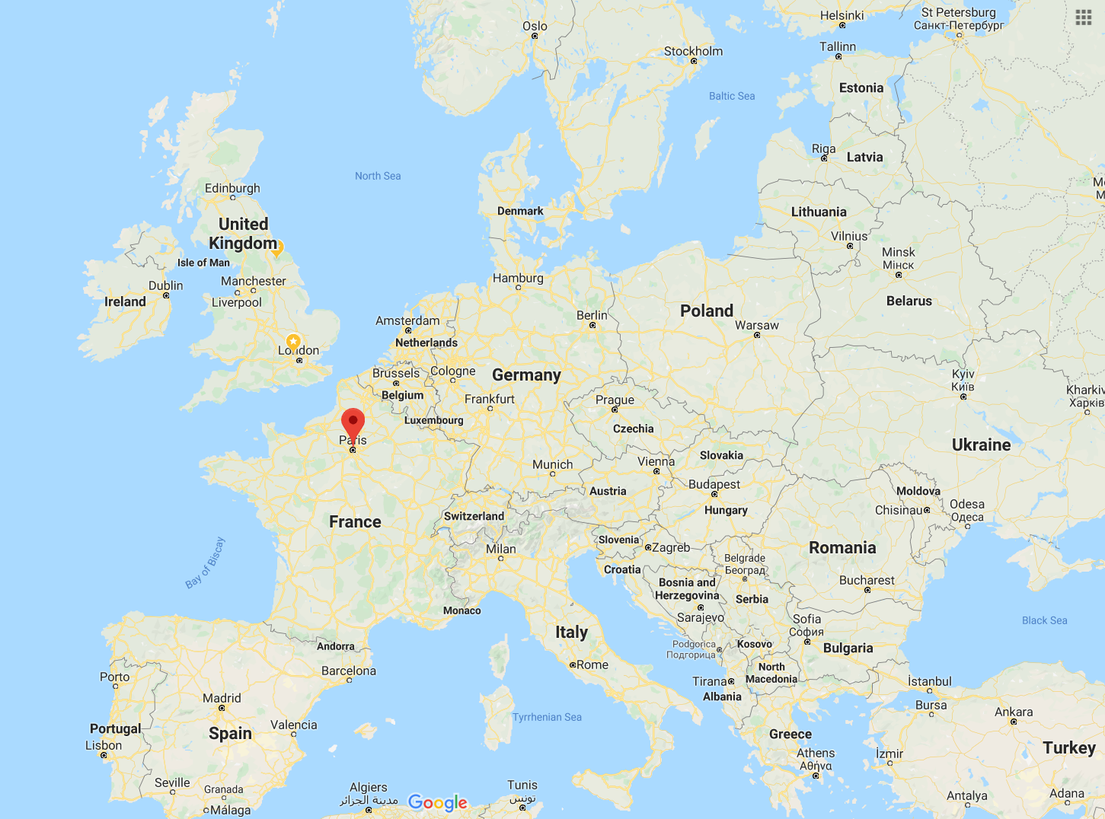

Slide 6

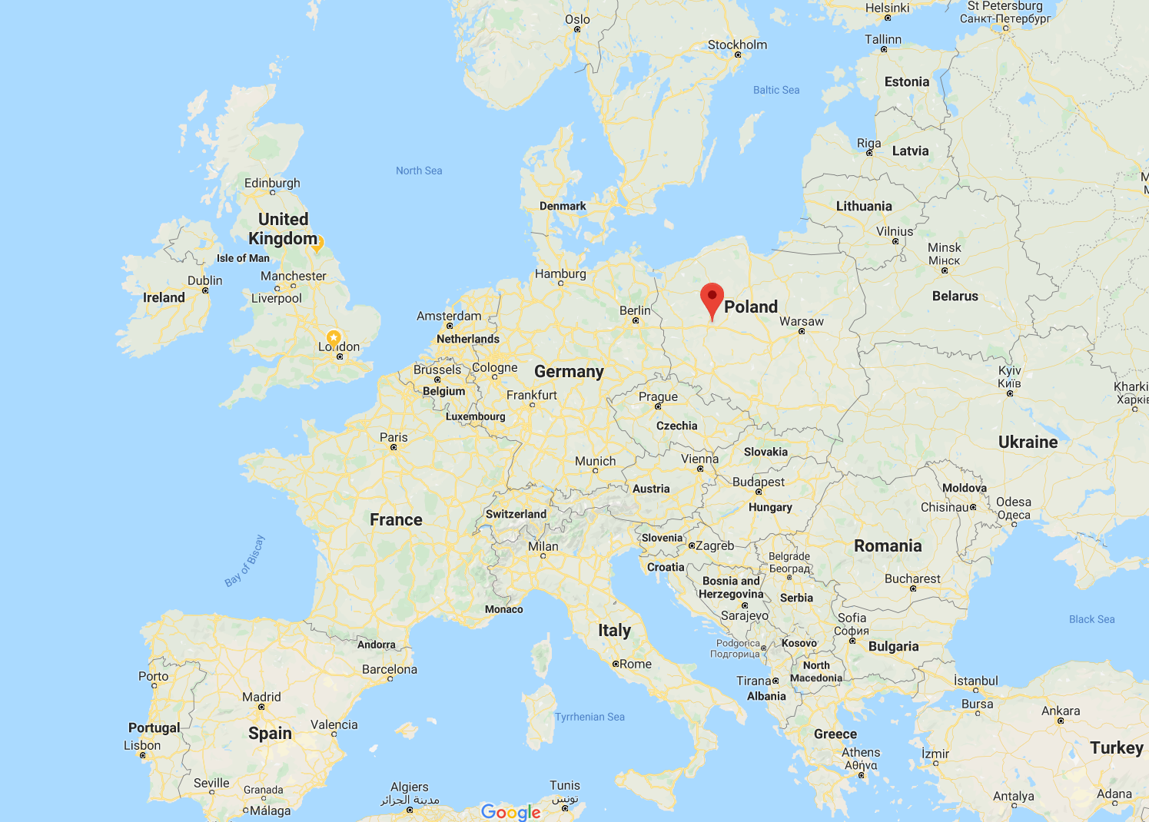

Slide 7

